Slide 1


VISUAL COMMUNICATION
Here is where your workshop begins

Slide 2
CONTENTS OF THIS TEMPLATE
Here’s what you’ll find in this Slidesgo template:
A slide structure based on a workshop, which you can easily adapt to your needs. For more info on how to edit the template, please visit Slidesgo School or read our FAQs.
A thanks slide, which you must keep so that proper credits for our design are given.
A resources slide, where you’ll find links to all the elements used in the template.
Instructions for use.
Final slides with:
The fonts and colors used in the template.
More infographic resources, whose size and color can be edited.
Sets of customizable icons of the following themes: general, business, avatar, creative process, education, help & support, medical, nature, performing arts, SEO & marketing, and teamwork.
You can delete this slide when you’re done editing the presentation.

Slide 3
01
02
TABLE OF CONTENTS
THEORY
LESSON
FEATURES OF THE TOPIC
03
04
ALL THE TIPS YOU NEED
PRACTICAL EXERCISE
Here you could describe the topic of the section
Here you could describe the topic of the section
Here you could describe the topic of the section
Here you could describe the topic of the section

Slide 4
INTRODUCTION
Mercury is the closest planet to the Sun and the smallest one in the Solar System—it’s only a bit larger than the Moon. The planet’s name has nothing to do with the liquid metal, since Mercury was named after the Roman messenger god

Slide 5
01
THEORY LESSON
You could enter a subtitle here if you need it

Slide 6
CONCEPT 1
CONCEPT 2
Mercury is the closest planet to the Sun and the smallest one in the Solar System—it’s only a bit larger than the Moon
Venus has a beautiful name and is the second planet from the Sun. It’s terribly hot, even hotter than Mercury

Slide 7
96.80%
This workshop has been useful for this percentage of people in their professional life

Slide 8
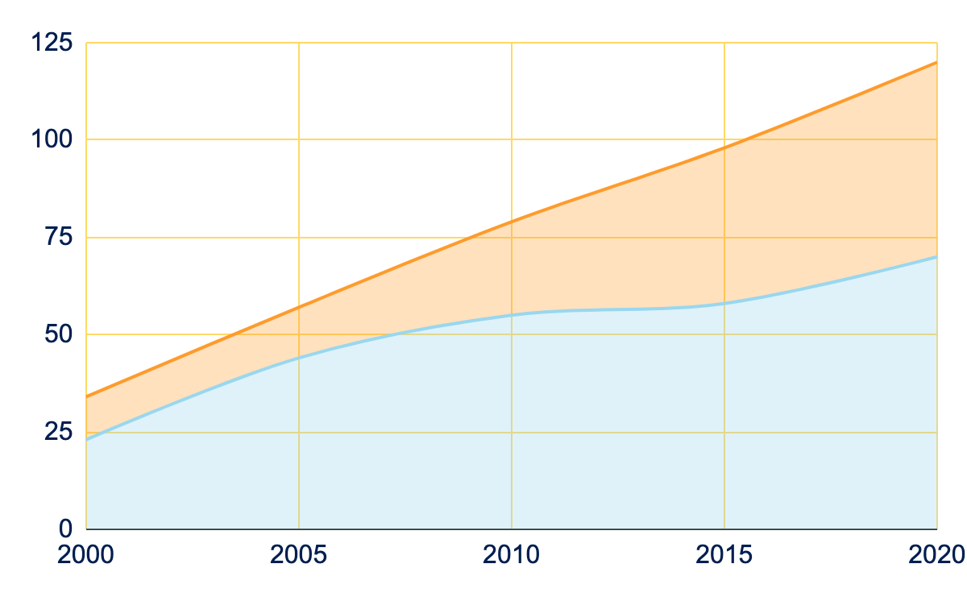
WORKSHOP EVOLUTION
To modify this graph, click on it, follow the link, change the data and paste the resulting graph here

Slide 9
WHAT IS THIS TOPIC ABOUT?
Jupiter
Venus
Mars
Jupiter is a gas giant and the biggest planet in the Solar System
Venus has a beautiful
name and is the second
planet from the Sun
Despite being red, Mars is a cold place full of iron oxide dust

Slide 10
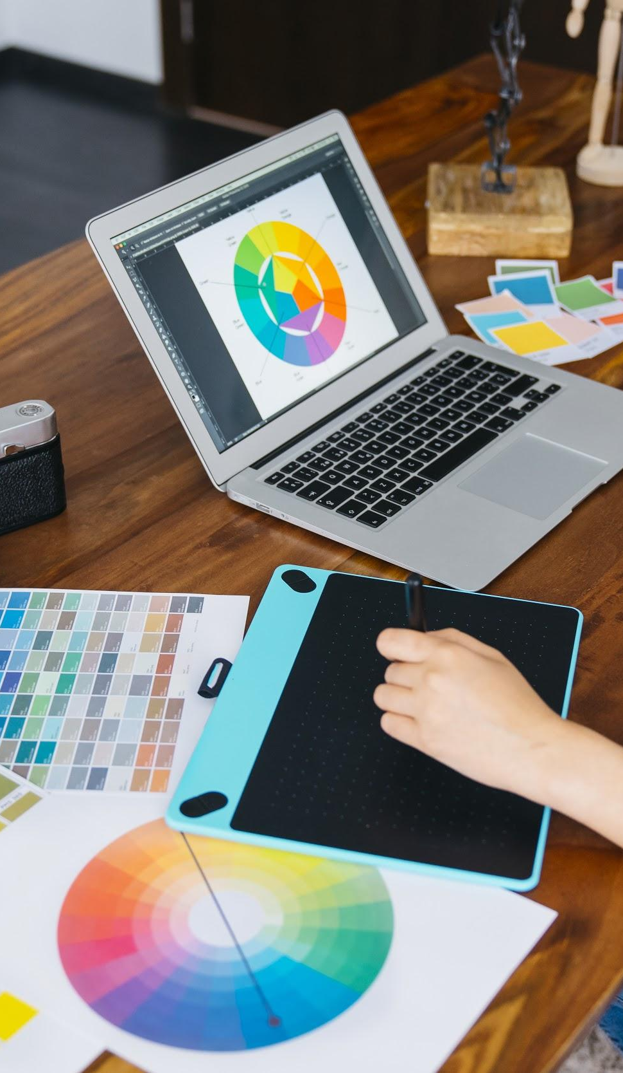
FEATURES OF THE TOPIC
Jupiter is a gas giant and the biggest planet in the Solar System
Here you can talk about the features of the topic
Here you can talk about the features of the topic
Here you can talk about the features of the topic
Here you can talk about the features of the topic

Slide 11
EXAMPLES
MARS
VENUS
JUPITER
SATURN
Despite being red, Mars is actually a cold place full of iron oxide dust
Venus has a beautiful
name and is the second
planet from the Sun
Jupiter is a gas giant and the biggest planet in the Solar System
Saturn is a gas giant, composed mostly of hydrogen and helium

Slide 15
CONTENTS
 | WEEK 1 | WEEK 2 | WEEK 3
LESSON | Mercury is the smallest one | Saturn is the ringed one | Jupiter is the biggest one
EXERCISE | Venus has a beautiful name | Mars is a cold place | Neptune is the farthest from us
PRACTICE | Earth is where we live on | Pluto is now a dwarf planet | Ceres is in the asteroid belt

Slide 16
OUR WORKSHOP WORLDWIDE
Mercury
Saturn

Slide 17
LESSON 1
WORKSHOP LESSONS
LESSON 5
LESSON 2
LESSON 4
LESSON 3
Mercury is the closest planet to the Sun
Venus is the second planet from the Sun
Saturn is composed of hydrogen and helium
Despite being red, Mars is a cold place
Jupiter is the biggest planet of them all

Slide 18
CALENDAR
January
March
May
LESSON 2
LESSON 4
LESSON 1
LESSON 3
LESSON 5
February
April
Saturn is the ringed one
Mars is actually cold
Mercury is the smallest one
Saturn has several rings
Earth is where we live on

Slide 19
RECOMMENDATIONS
MERCURY
JUPITER
MARS
SATURN
NEPTUNE
VENUS
Mercury is the closest
planet to the Sun
It’s the biggest planet in the Solar System
Despite being red, Mars is a cold place
Saturn is composed of hydrogen and helium
It’s the farthest planet from the Sun
Venus is the second planet from the Sun

Slide 20
PRACTICAL EXERCISE
Mercury is the closest planet to the Sun and the smallest one in the Solar System—it’s only a bit larger than our Moon. The planet’s name has nothing to do with the liquid metal, since Mercury was named after the Roman messenger god

Slide 21
RESOURCES
Did you like the resources on this template? Get them for free at our other websites.
VECTORS:
Flat design geometric shapes background
Geometric models flat background
PHOTOS:
Happy woman dancing in front of colorful graffiti wall
Graphic designer with laptop and graphic tablet
ICONS:
Graphic Design Icon Pack

