Slide 1


Intellectual Property
Here is where your thesis defense begins

Slide 2
Contents of This Template
Here’s what you’ll find in this Slidesgo template:
A slide structure based on a thesis defense, which you can easily adapt to your needs. For more info on how to edit the template, please visit Slidesgo School or read our FAQs.
An assortment of illustrations that are suitable for use in the presentation can be found in the alternative resources slide.
A thanks slide, which you must keep so that proper credits for our design are given.
A resources slide, where you’ll find links to all the elements used in the template.
Instructions for use.
Final slides with:
The fonts and colors used in the template.
More infographic resources, whose size and color can be edited.
Sets of customizable icons of the following themes: general, business, avatar, creative process, education, help & support, medical, nature, performing arts, SEO & marketing, and teamwork.
You can delete this slide when you’re done editing the presentation.

Slide 3
Objectives
Methodology
01
02
Results Analysis
Conclusions
03
04
Here you could describe the
topic of the section
Here you could describe the
topic of the section
Here you could describe the
topic of the section
Here you could describe the
topic of the section

Slide 4
Introduction
Mercury is the closest planet to the Sun and the smallest one in the Solar System—it’s only a bit larger than the Moon. The planet’s name has nothing to do with the liquid metal, since Mercury was actually named after the Roman messenger god

Slide 5
—Someone Famous
“This is a quote. Words full of wisdom that someone important said and can make the reader get inspired.”

Slide 6
01
Objectives
You could enter a subtitle here if you need it

Slide 7
Study Objectives
Mercury
Neptune
Jupiter
Mercury is the closest
planet to the Sun and the
smallest one in the Solar
System
Neptune is the farthest planet from the Sun and the fourth-largest by diameter in the Solar System
Despite being red, Mars is a cold place. It’s full of iron oxide dust, giving the planet its reddish cast

Slide 8
Literature Review
Theory 1
Theory 2
Mercury is the closest planet to the Sun and the smallest one in the Solar System
Venus has a beautiful name and is the second planet from the Sun

Slide 9
Schedule
January
February
March
April
Venus has a beautiful name
Saturn is the ringed planet
Mercury is the smallest planet
Despite being red, Mars is cold

Slide 10

A Picture Is Worth a Thousand Words

Slide 11
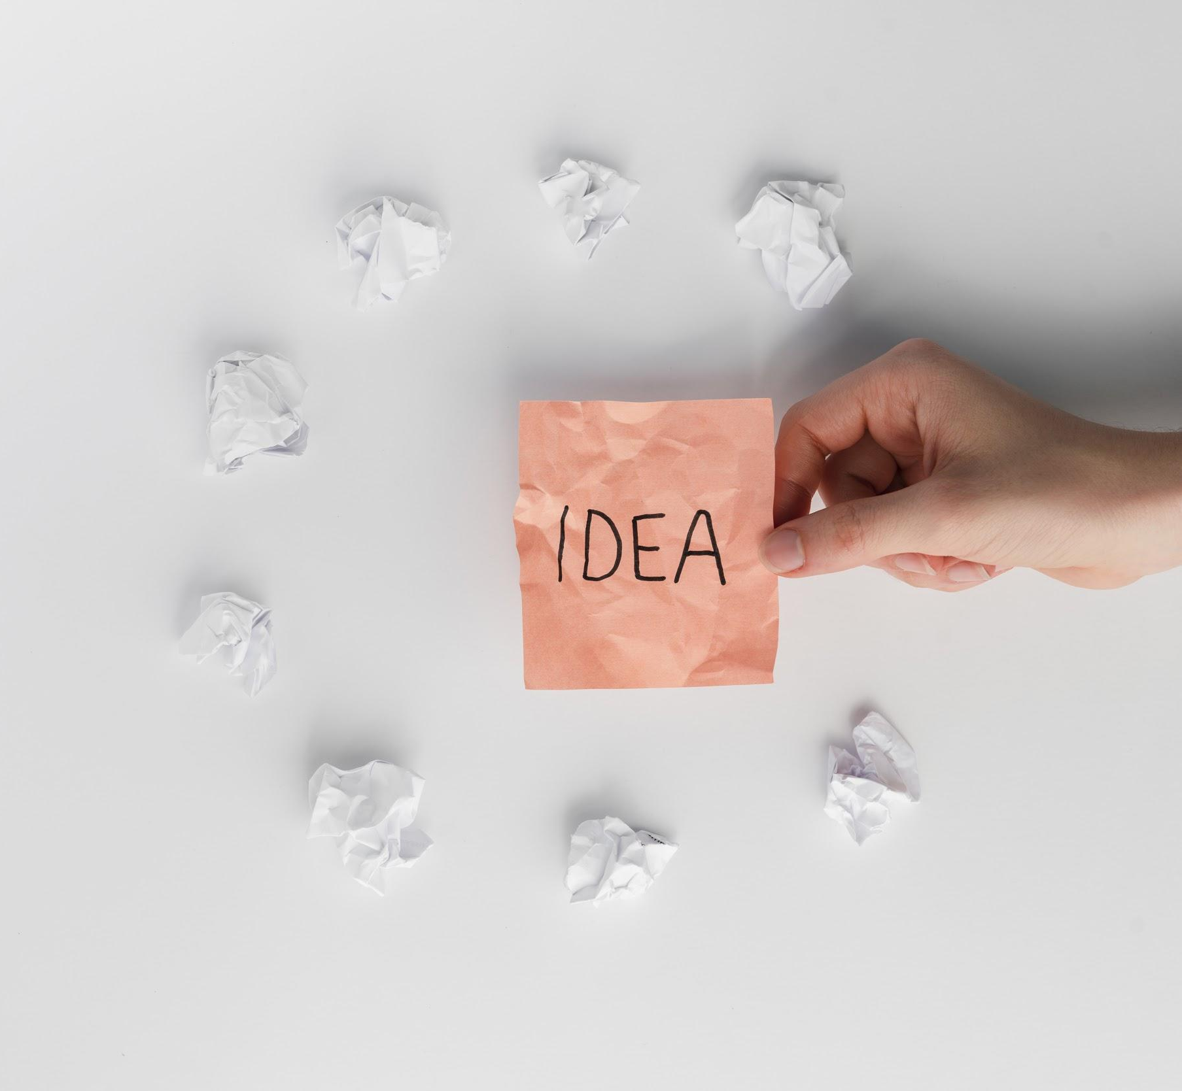
A Picture Always Reinforces the Concept
Images reveal large amounts of data, so remember: use an image instead of long texts

Slide 12
Methodology
Research
Analysis
Data Study
Comparison
Venus is the second planet from the Sun
Jupiter is the biggest planet
in the Solar System
Despite being red, Mars is actually a cold place
Saturn is composed mostly of hydrogen and helium

Slide 13
Table
 | Test 1 | Test 2 | Test 3 | Test 4
Concept 1
Concept 2
Concept 3
Concept 4

Slide 14
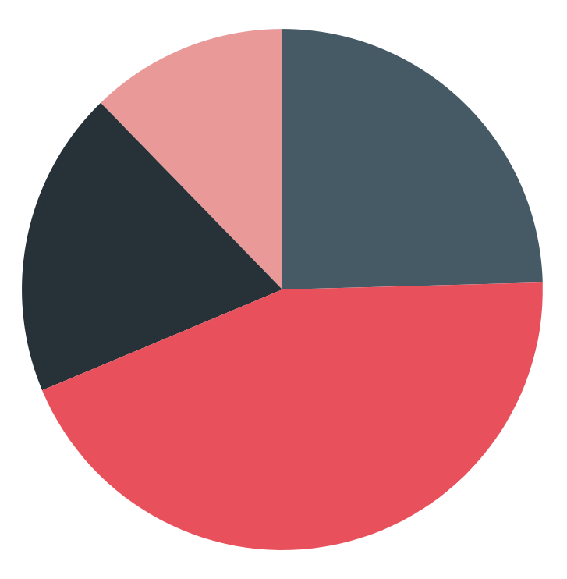
Results Analysis
51%
49%
Mars
Jupiter
Concept 1
Saturn
Venus
To modify this graph, click on it, follow the link, change the data and paste the resulting graph here
Concept 2

Slide 15
Results Analysis
78.89%
Large-sized numbers catch your audience’s attention

Slide 16
Sampling
Jupiter is a gas giant and the biggest planet in the Solar System
Here you can describe the sample chosen for the study
Here you can describe the sample chosen for the study
Here you can describe the sample chosen for the study

Slide 17
Conclusions
Conclusion 1
Conclusion 2
Here you can explain the conclusions
Here you can explain the conclusions
Here you can explain the conclusions
Here you can explain the conclusions
Here you can explain the conclusions
Here you can explain the conclusions

Slide 18
Reviewing Concepts
Mercury
Venus
Mars
Jupiter
Saturn
Neptune
Mercury is the closest planet to the Sun
Venus is the second planet from the Sun
Despite being red, Mars is actually a cold place
It’s the biggest planet in the Solar System
Saturn is composed mostly of hydrogen and helium
Neptune is the farthest planet from the Sun

Slide 19
References
AUTHOR (YEAR). Title of the publication. Publisher
AUTHOR (YEAR). Title of the publication. Publisher
AUTHOR (YEAR). Title of the publication. Publisher
AUTHOR (YEAR). Title of the publication. Publisher
AUTHOR (YEAR). Title of the publication. Publisher
AUTHOR (YEAR). Title of the publication. Publisher
AUTHOR (YEAR). Title of the publication. Publisher

