Slide 1
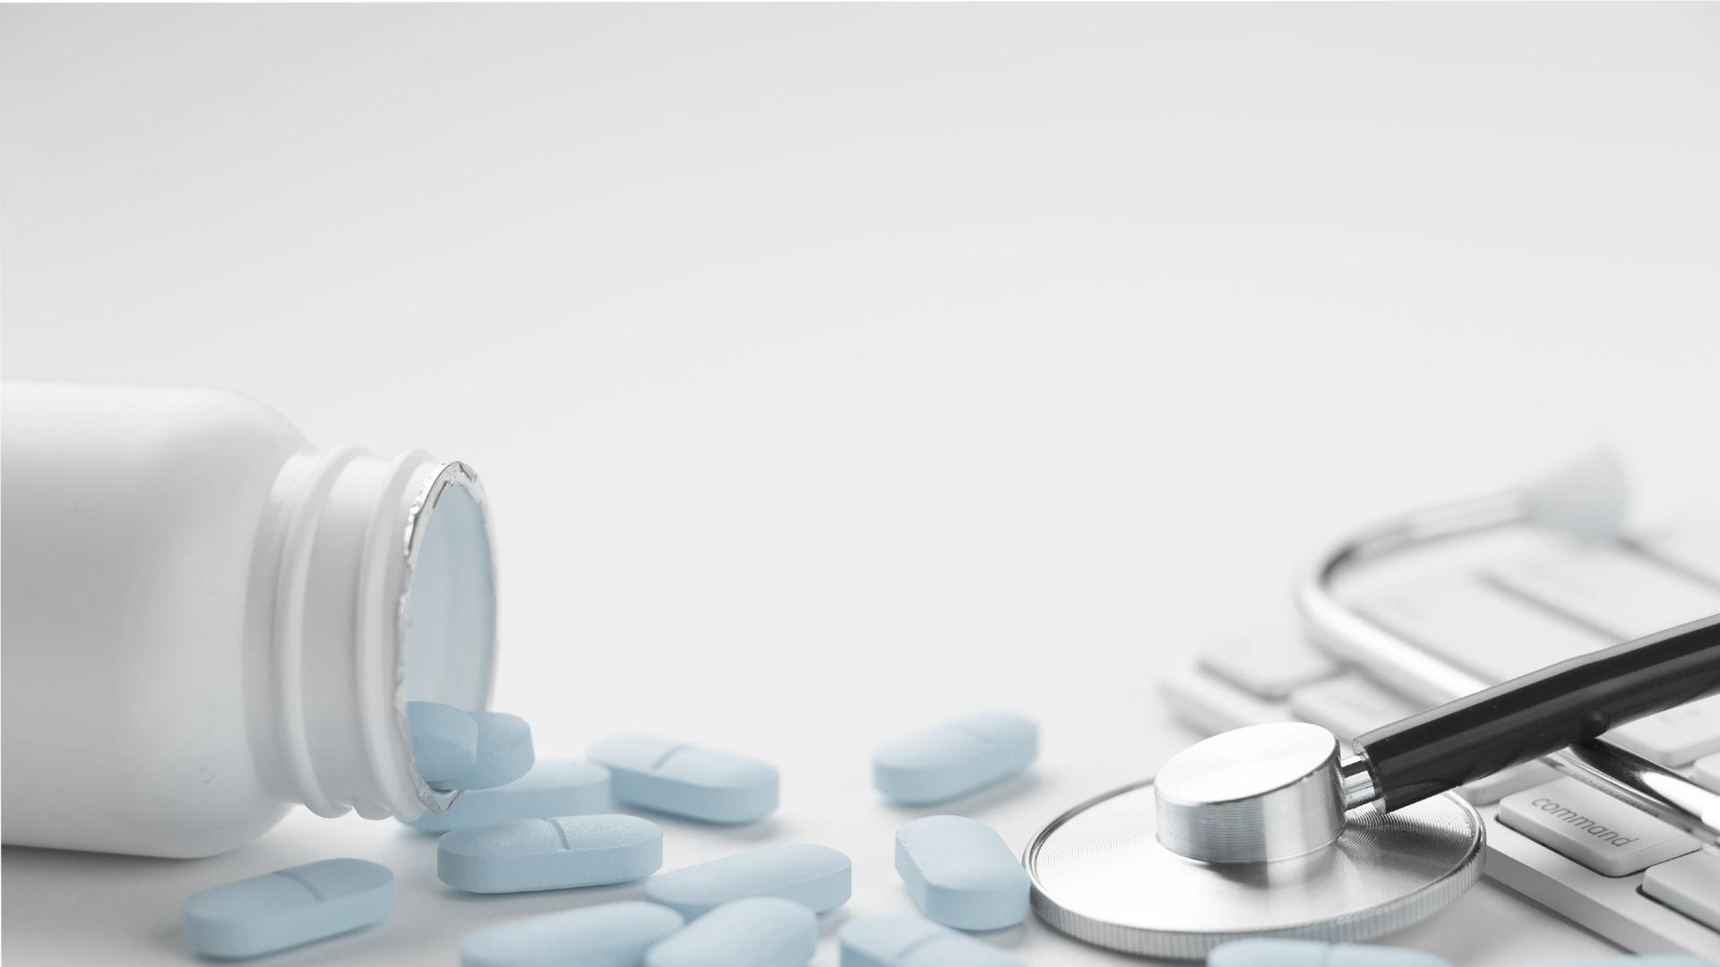


MINIMALIST DISEASE
Here is where your presentation begins

Slide 2
CONTENTS OF THIS TEMPLATE
Here’s what you’ll find in this Slidesgo template:
A slide structure based on a disease presentation, which you can easily adapt to your needs. For more info on how to edit the template, please visit Slidesgo School or read our FAQs.
An assortment of pictures to use in the presentation can be found in the alternative resources slide.
A thanks slide, which you must keep so that proper credits for our design are given.
A resources slide, where you’ll find links to all the elements used in the template.
Instructions for use.
Final slides with:
The fonts and colors used in the template.
More infographic resources, whose size and color can be edited.
Sets of customizable icons of the following themes: general, business, avatar, creative process, education, help & support, medical, nature, performing arts, SEO & marketing, and teamwork.
You can delete this slide when you’re done editing the presentation.

Slide 3
01
04
ABOUT THE DISEASE
PATHOLOGY
02
05
TABLE OF CONTENTS
DIAGNOSIS
TREATMENT
03
06
RECOMMENDATIONS
CONCLUSIONS
Here you could describe the topic of the section
Here you could describe the topic of the section
Here you could describe the topic of the section
Here you could describe the topic of the section
Here you could describe the topic of the section
Here you could describe the topic of the section

Slide 4

INTRODUCTION
Mercury is the closest planet to the Sun and the smallest one in the Solar System—it’s only a bit larger than our Moon. The planet’s name has nothing to do with the liquid metal, since it was named after the Roman messenger god, Mercury

Slide 5

01
ABOUT THE DISEASE
Here you could describe the topic of the section

Slide 6
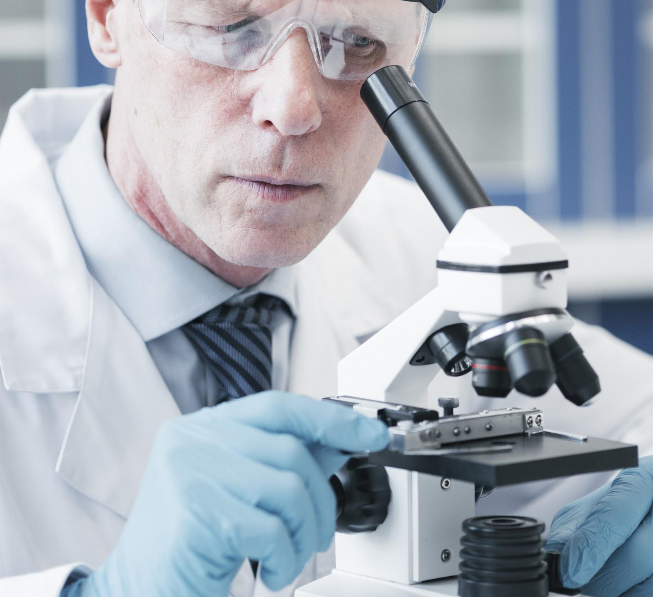
ABOUT THE DISEASE
Despite being red, Mars is actually a cold place. The planet is full of iron oxide, which gives the planet its reddish cast
Jupiter is a gas giant and the biggest planet in our Solar System. It’s also the fourth-brightest object in the sky
Venus has a beautiful name and is the second planet from the Sun. It’s terribly hot and its atmosphere is extremely poisonous

Slide 7

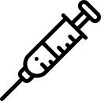
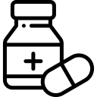

ABOUT THE DISEASE
MARS
SATURN
JUPITER
MERCURY
Despite being red, Mars is actually a cold place. It’s full of iron oxide dust, which gives the planet its reddish cast
Venus has a beautiful name and is the second planet from the Sun. It’s terribly hot, even hotter than Mercury
Jupiter is a gas giant and the biggest planet in our Solar System. It’s also the fourth-brightest object in the sky
Mercury is the closest planet to the Sun and the smallest one in the Solar System—it’s only a bit larger than our Moon

Slide 8
GRADE 2
GRADE 1
CONCEPTS AND TYPOLOGY
GRADE 3
Jupiter is a gas giant and the biggest planet in our Solar System. It’s also the fourth-brightest object in the sky
Despite being red, Mars is actually a cold place. It’s full of iron oxide dust, which gives the planet its reddish cast
Venus has a beautiful name and is the second planet from the Sun. It’s terribly hot, even hotter than Mercury

Slide 9
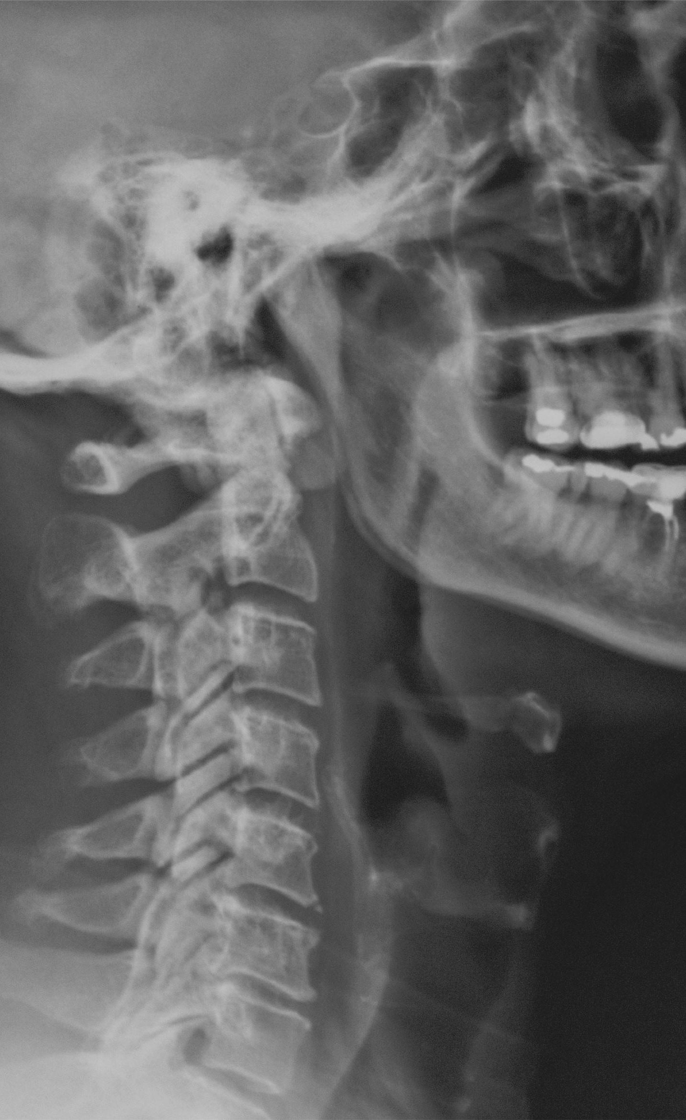
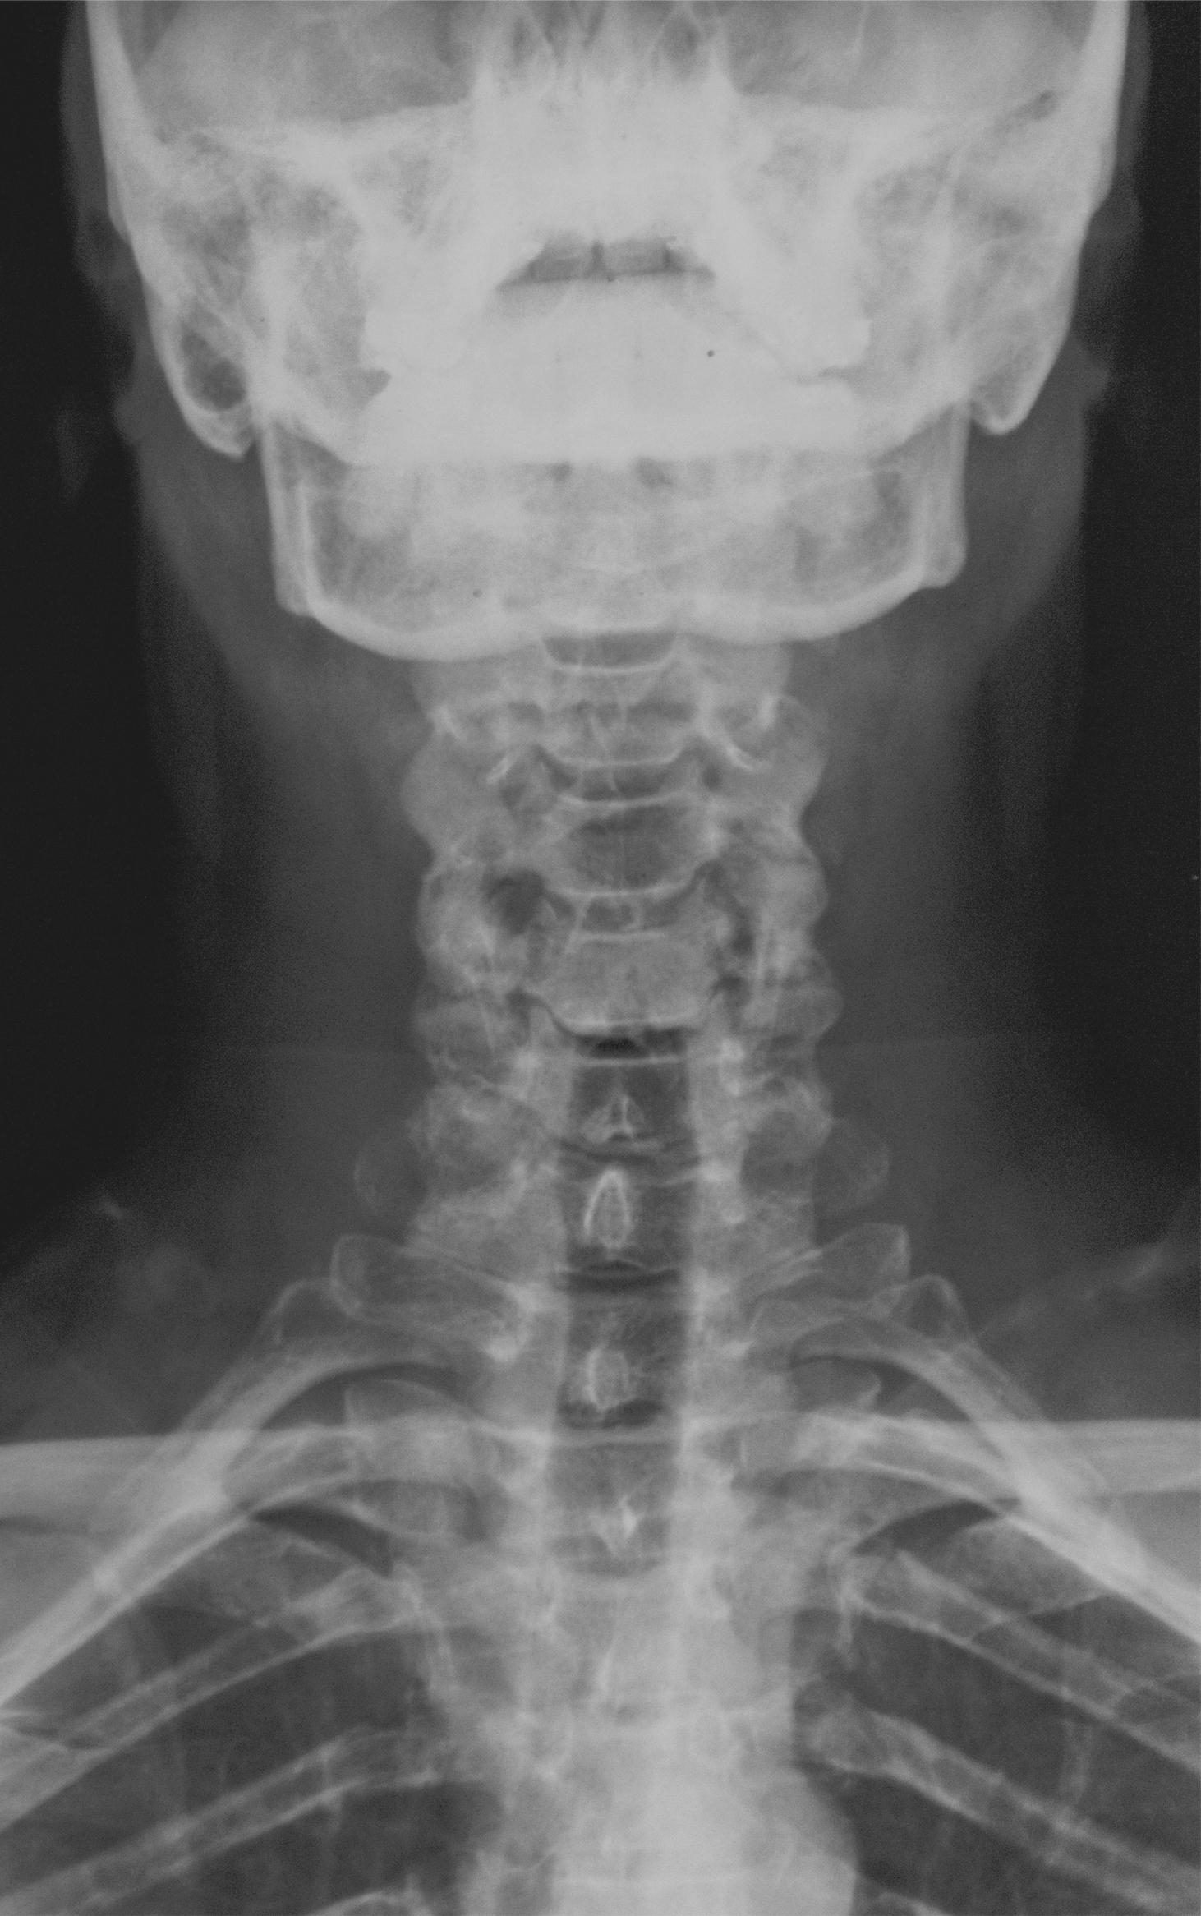
PATHOLOGY
Neptune is the farthest planet from the Sun
Despite being red, Mars is actually a cold place
Mercury is the closest planet to
the Sun
Venus has a beautiful name, but it’s terribly hot

Slide 10
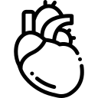


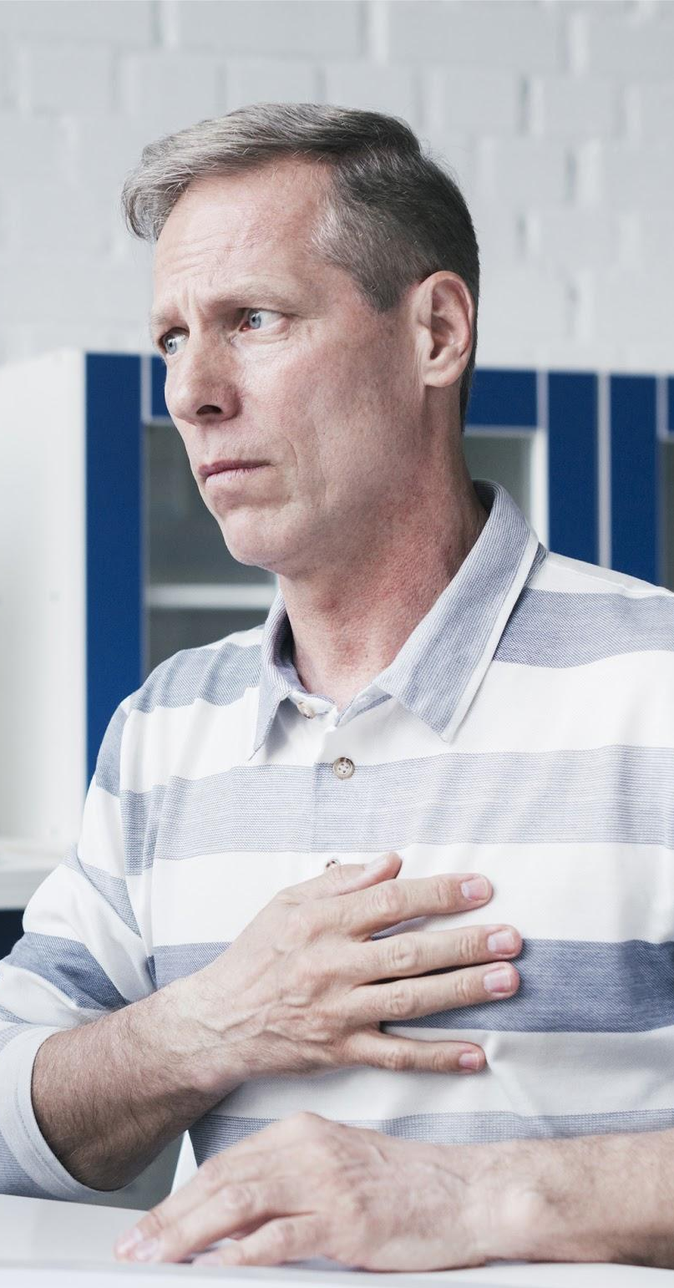
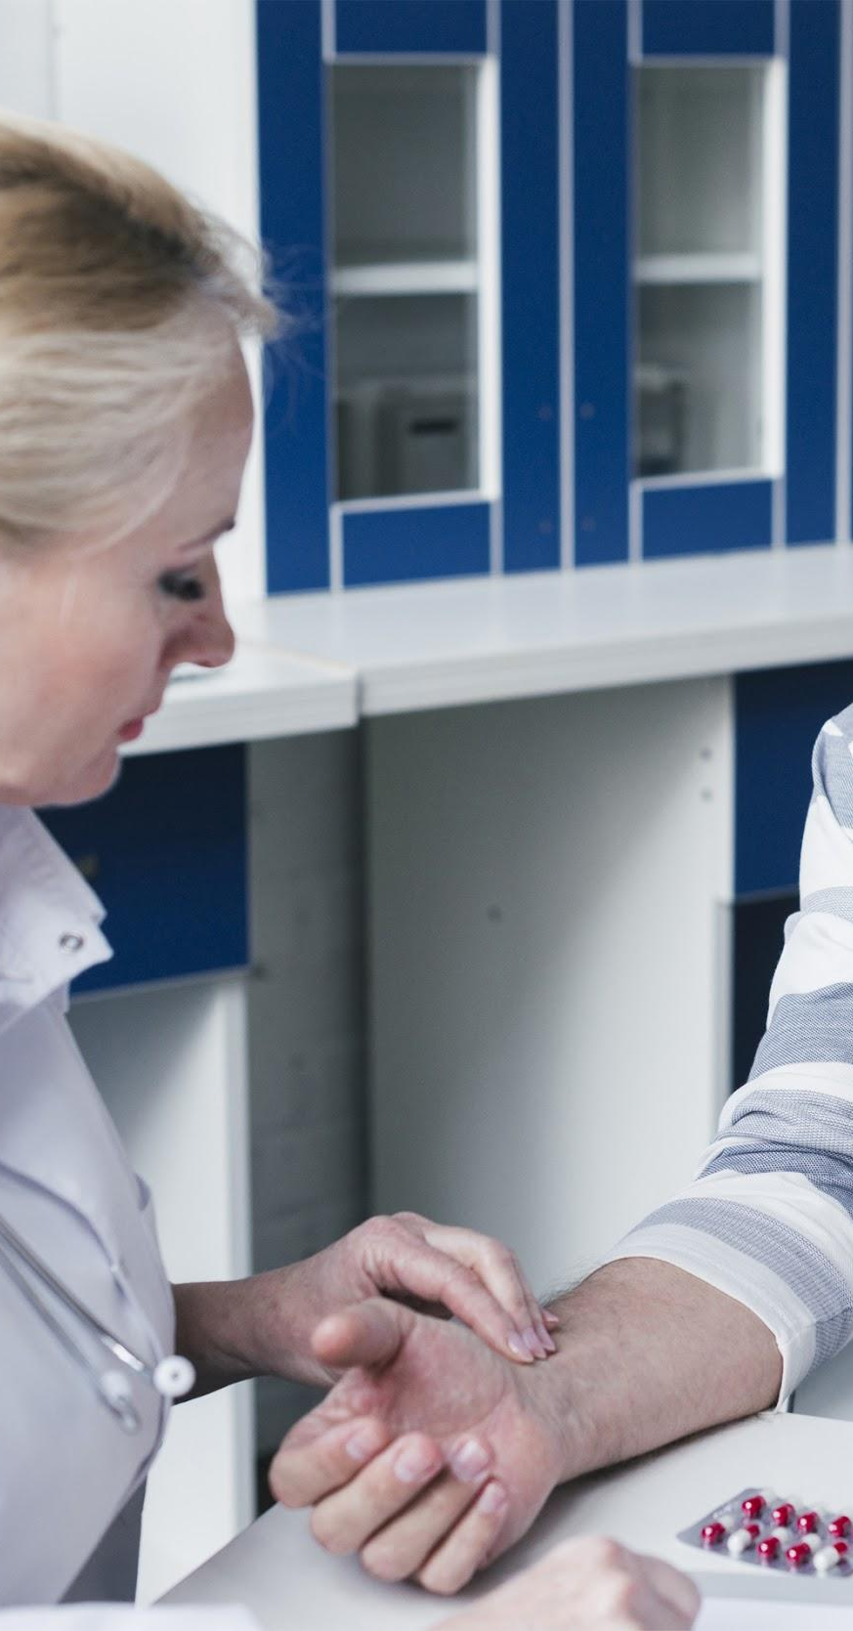
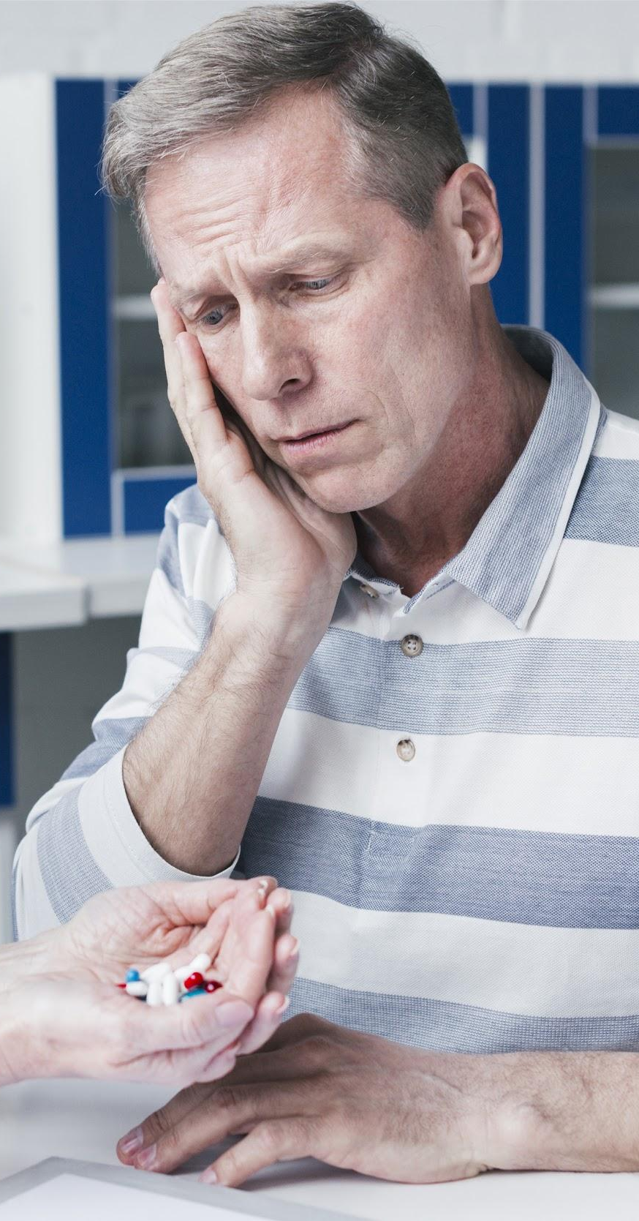
SYMPTOMS OF THE DISEASE
SATURN
MARS
JUPITER
This is the ringed one. It’s a gas giant, composed mostly of hydrogen and helium
Despite being red, Mars is actually a cold place. The planet is full of iron oxide dust
Jupiter is a gas giant and the biggest planet in our Solar System

Slide 11

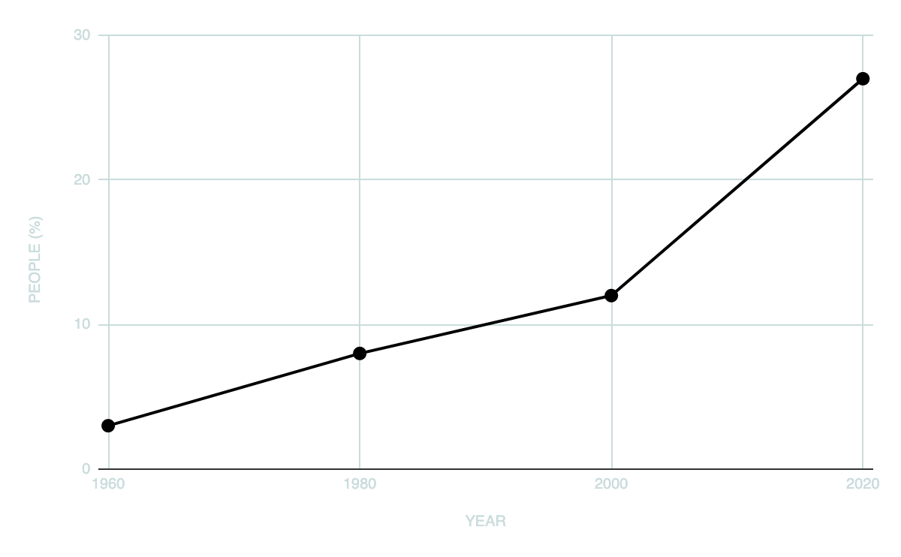







RISK FACTORS
MAIN CAUSES
DISEASE SPREAD
RISK GROUPS
If you want to modify this graph, click on it, follow the link, change the data and replace it

Slide 12
MERCURY
150,000
KEY NUMBERS
NEPTUNE
SATURN
VENUS
30,000
70,000
50,000
Neptune is the farthest planet from the Sun and the fourth-largest by diameter
This is the ringed one. It’s a gas giant, composed mostly of hydrogen and helium
Venus has a beautiful name and is the second planet from the Sun. It’s terribly hot

Slide 13
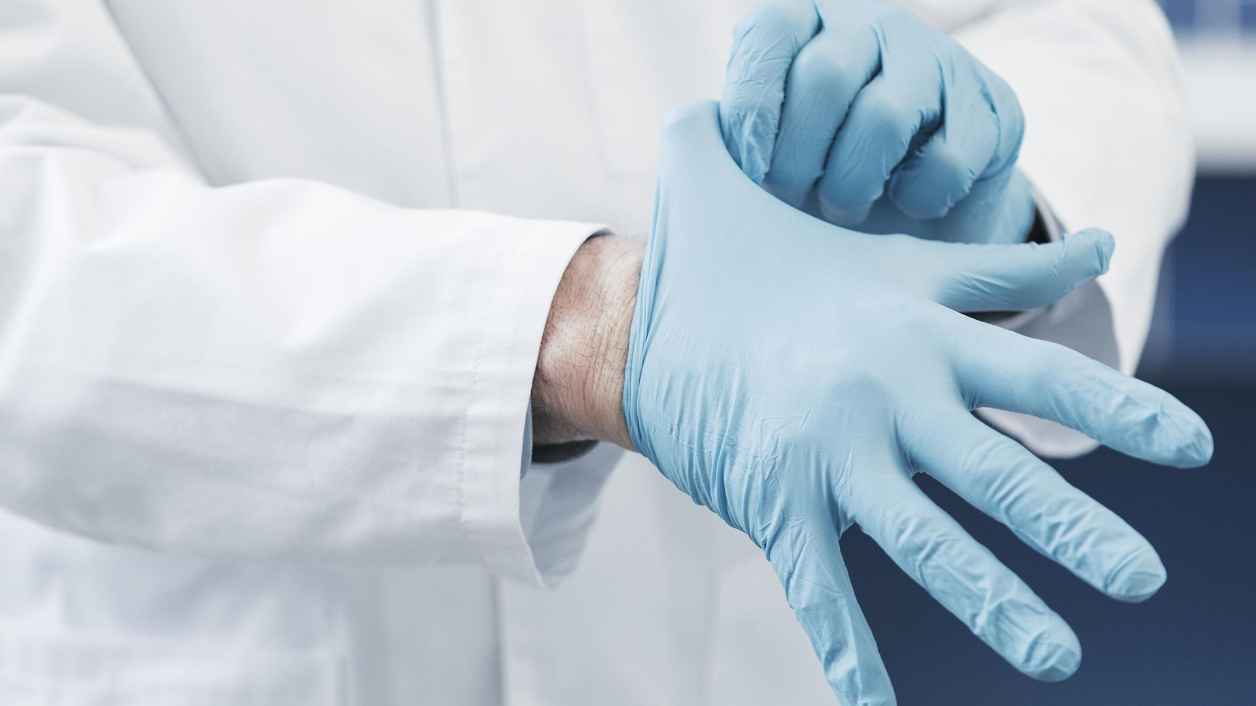
—Someone famous
“This is a quote. Words full of wisdom that someone important said and can make the reader get inspired.”

Slide 14
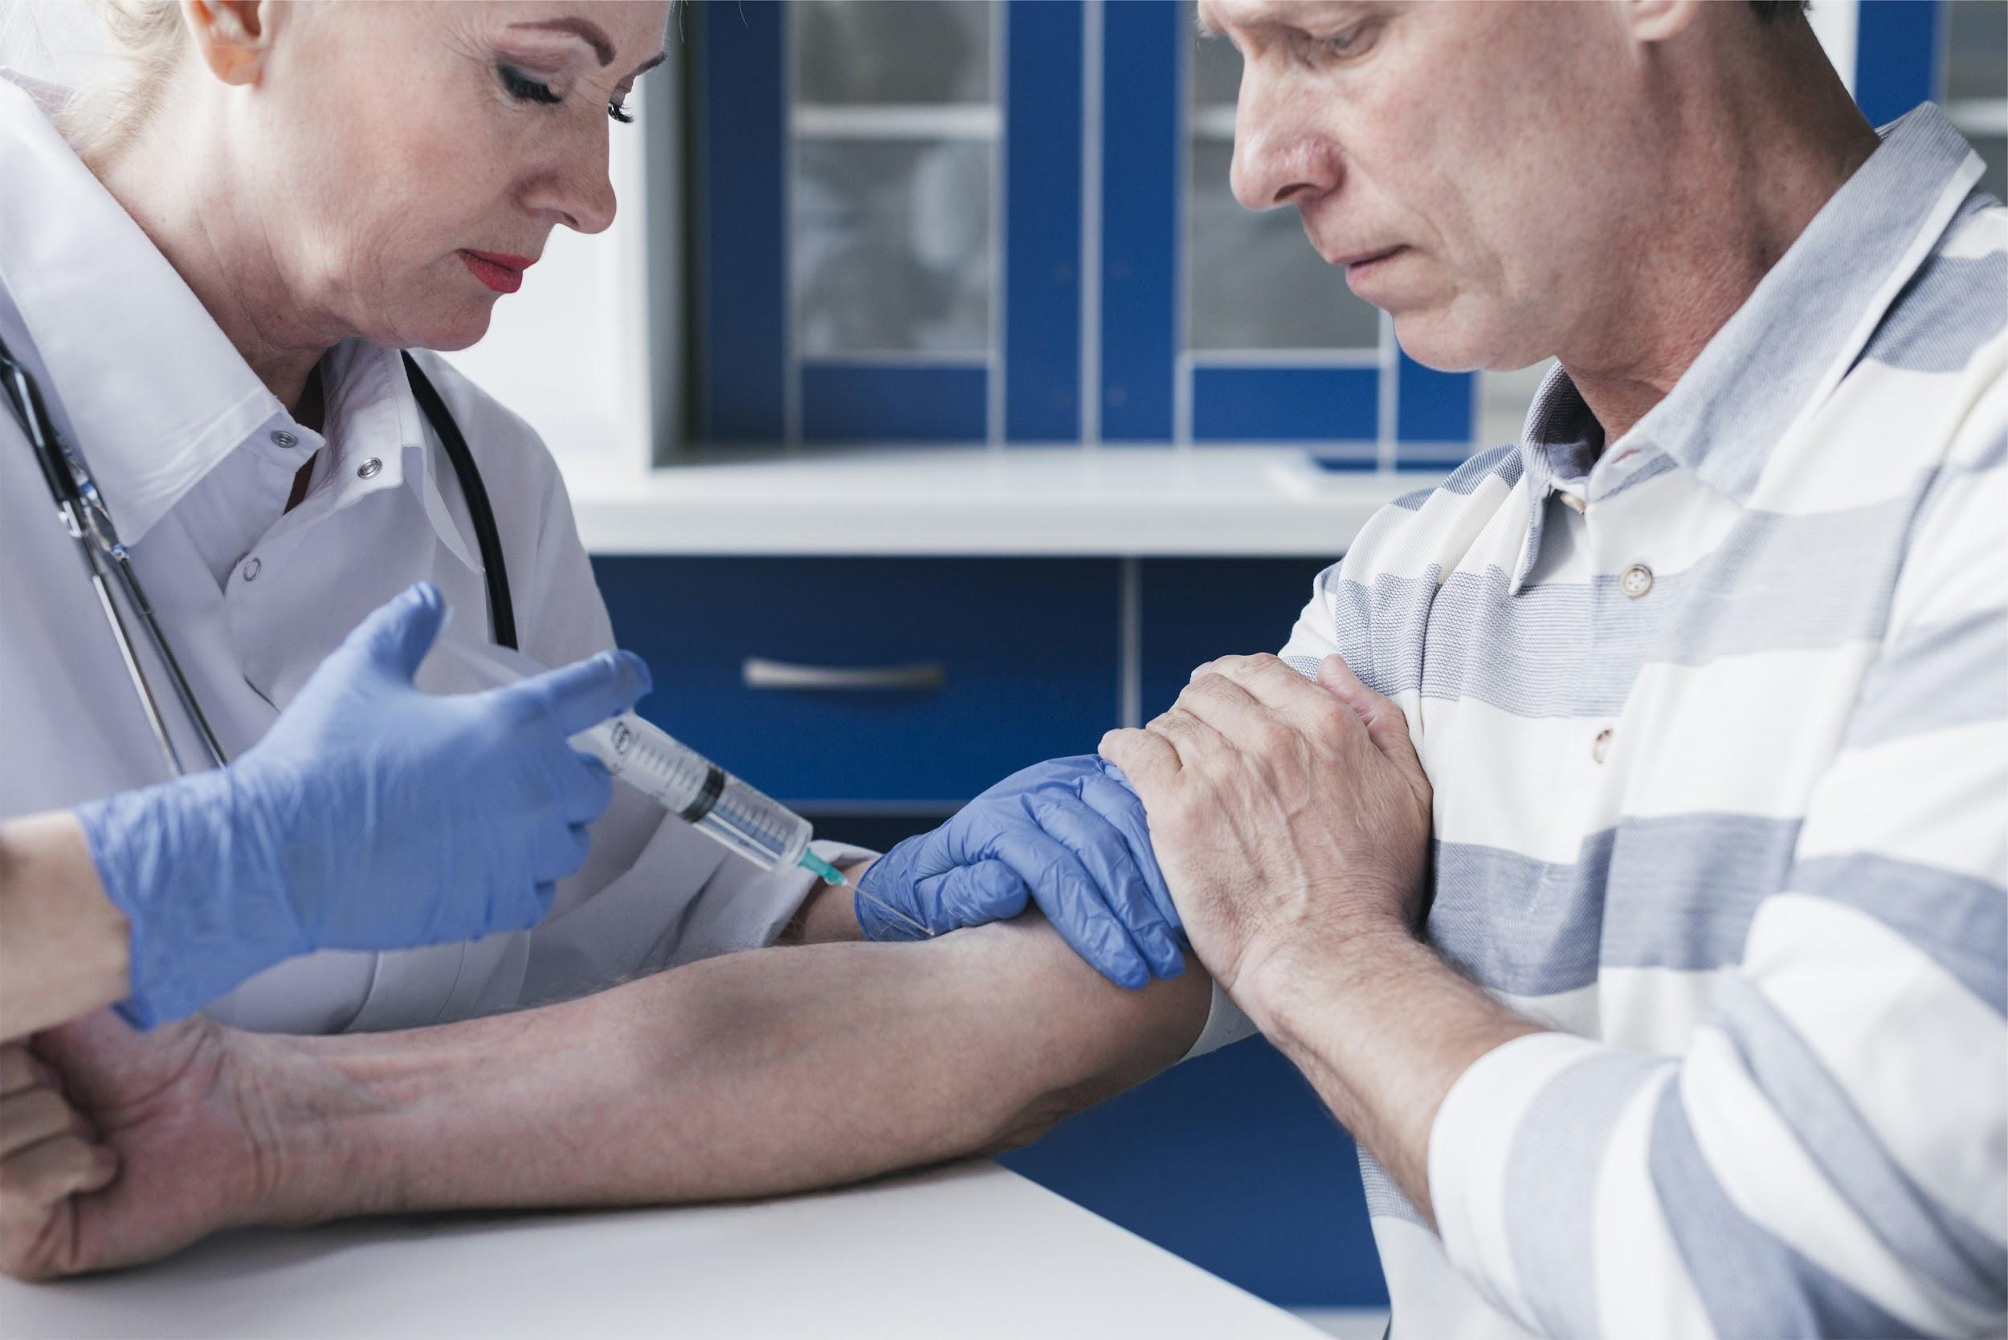
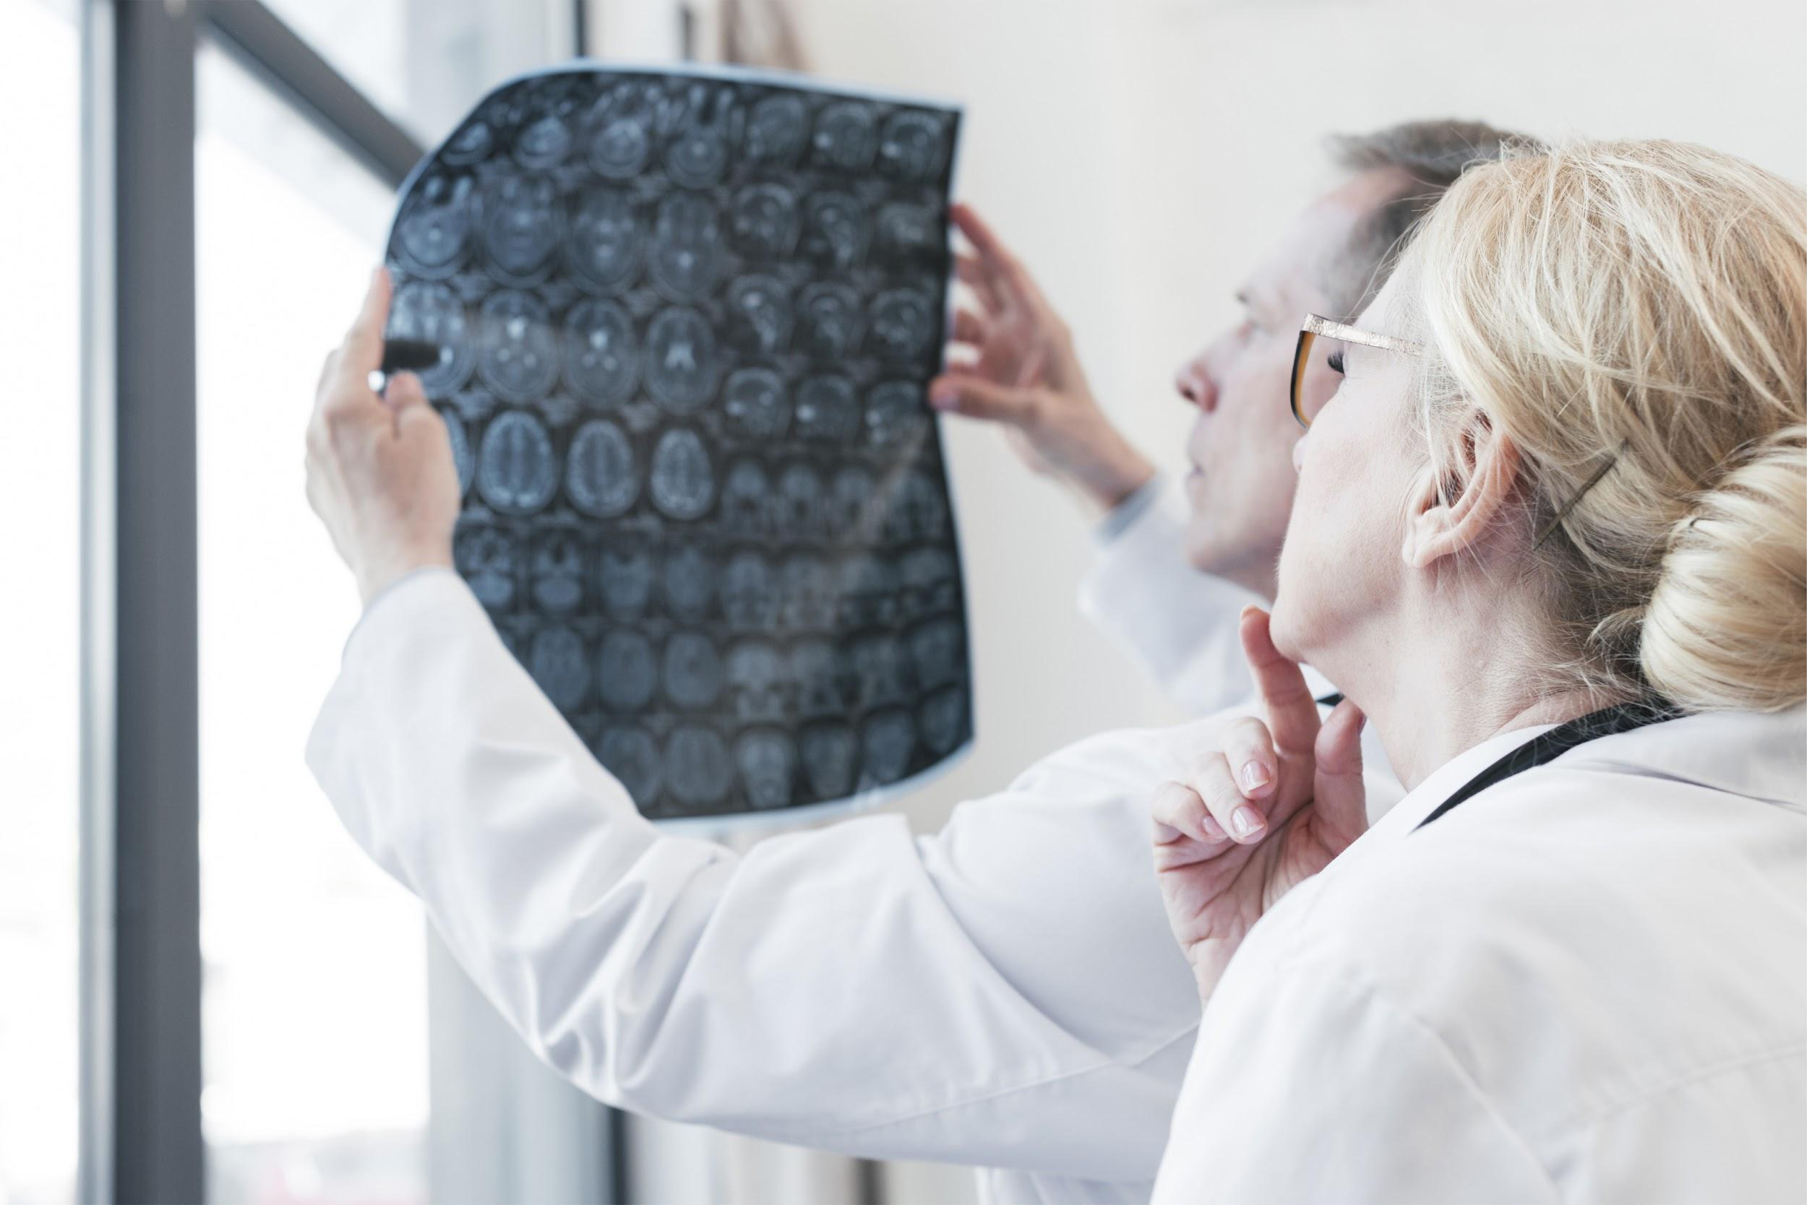
DIAGNOSIS
NEPTUNE
SATURN
Neptune is the farthest planet from the Sun and the fourth-largest by diameter in our Solar System
Yes, this is the ringed one. It’s a gas giant, composed mostly of hydrogen and helium

Slide 15
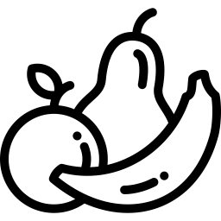



PREVENTION
RELAX
Despite being red, Mars is actually a cold place
HEALTHY FOOD
Mercury is the closest planet to the Sun
CHECKUPS
Venus has a beautiful name, but it’s very hot
SPORT
Neptune is the farthest planet from the Sun

Slide 16
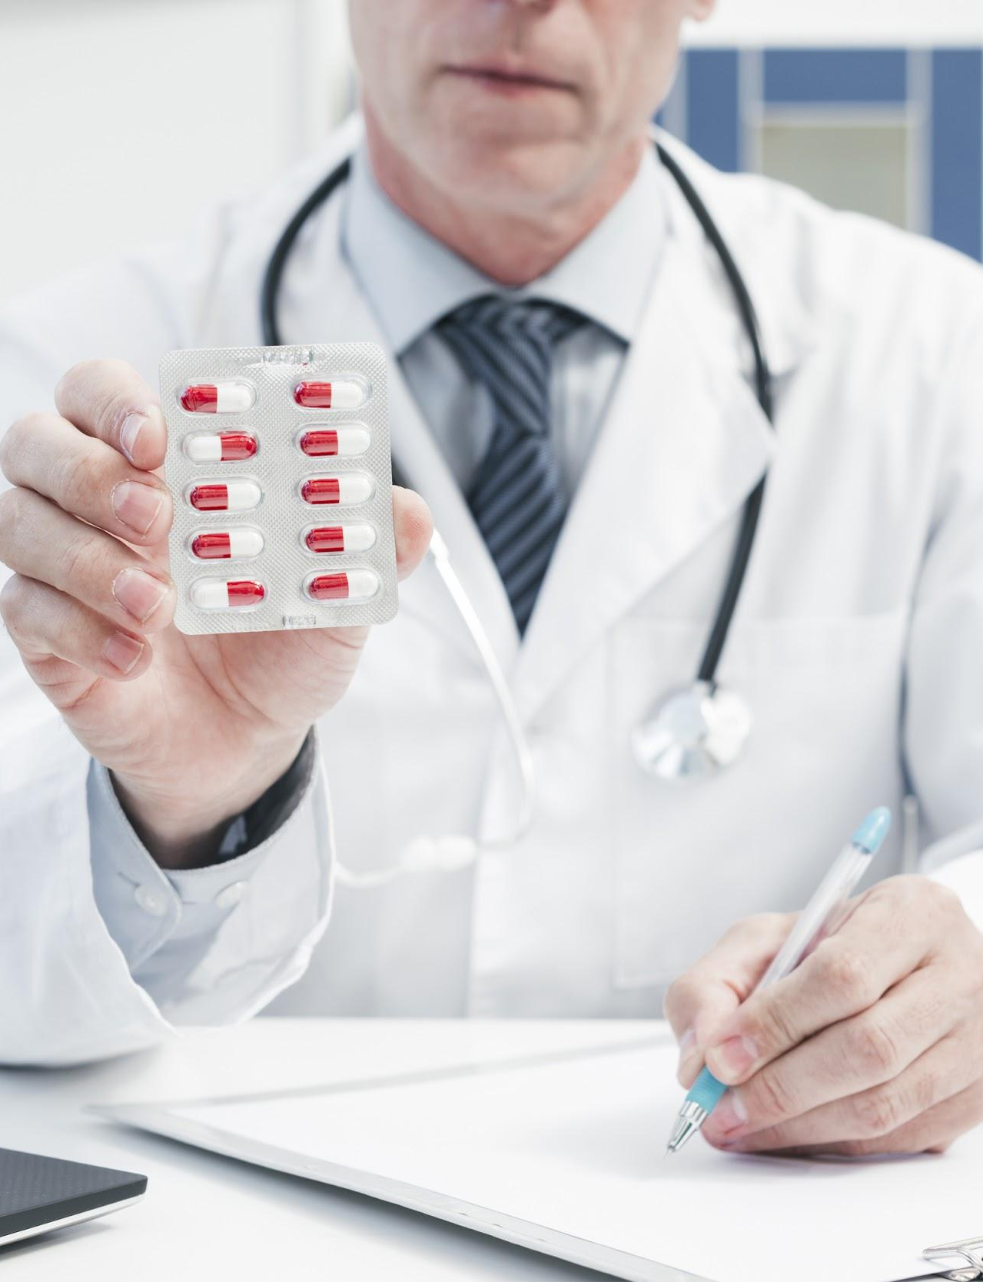
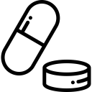


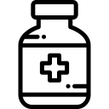

TREATMENT
Despite being red, Mars is actually a cold place
Jupiter is a gas giant and the biggest planet
Neptune is the farthest planet from the Sun
Venus has a beautiful name, but it’s terribly hot
Mercury is the closest planet to the Sun

Slide 17


WHAT YOU SHOULD DO
WHAT YOU SHOULD AVOID
RECOMMENDATIONS
Here you can describe what the patient should do
Here you can describe what the patient should do
Here you can describe what the patient should do
Here you can describe what the patient should do
Here you can describe what the patient should do
Here you can describe what the patient should do
Here you can describe what the patient shouldn’t do
Here you can describe what the patient shouldn’t do
Here you can describe what the patient shouldn’t do
Here you can describe what the patient shouldn’t do
Here you can describe what the patient shouldn’t do
Here you can describe what the patient shouldn’t do

Slide 18
PREVALENCE
Despite being red, Mars is actually a cold place. It’s full of iron oxide dust, which gives the planet its reddish cast

Slide 19

MARS
VENUS
MERCURY
SATURN
CONCLUSIONS
JUPITER
NEPTUNE
Despite being red, Mars is actually a cold place
Venus has a beautiful name, but it’s very hot
Mercury is the closest planet to the Sun
Saturn is the ringed one. It’s a gas giant
It’s the biggest planet in our Solar System
Neptune is the farthest planet from the Sun

Slide 20



JENNA DOE
OUR TEAM
JOHN JAMES
JANE PATTERSON
You can replace the image on the screen with your own
You can replace the image on the screen with your own
You can replace the image on the screen with your own

Slide 21
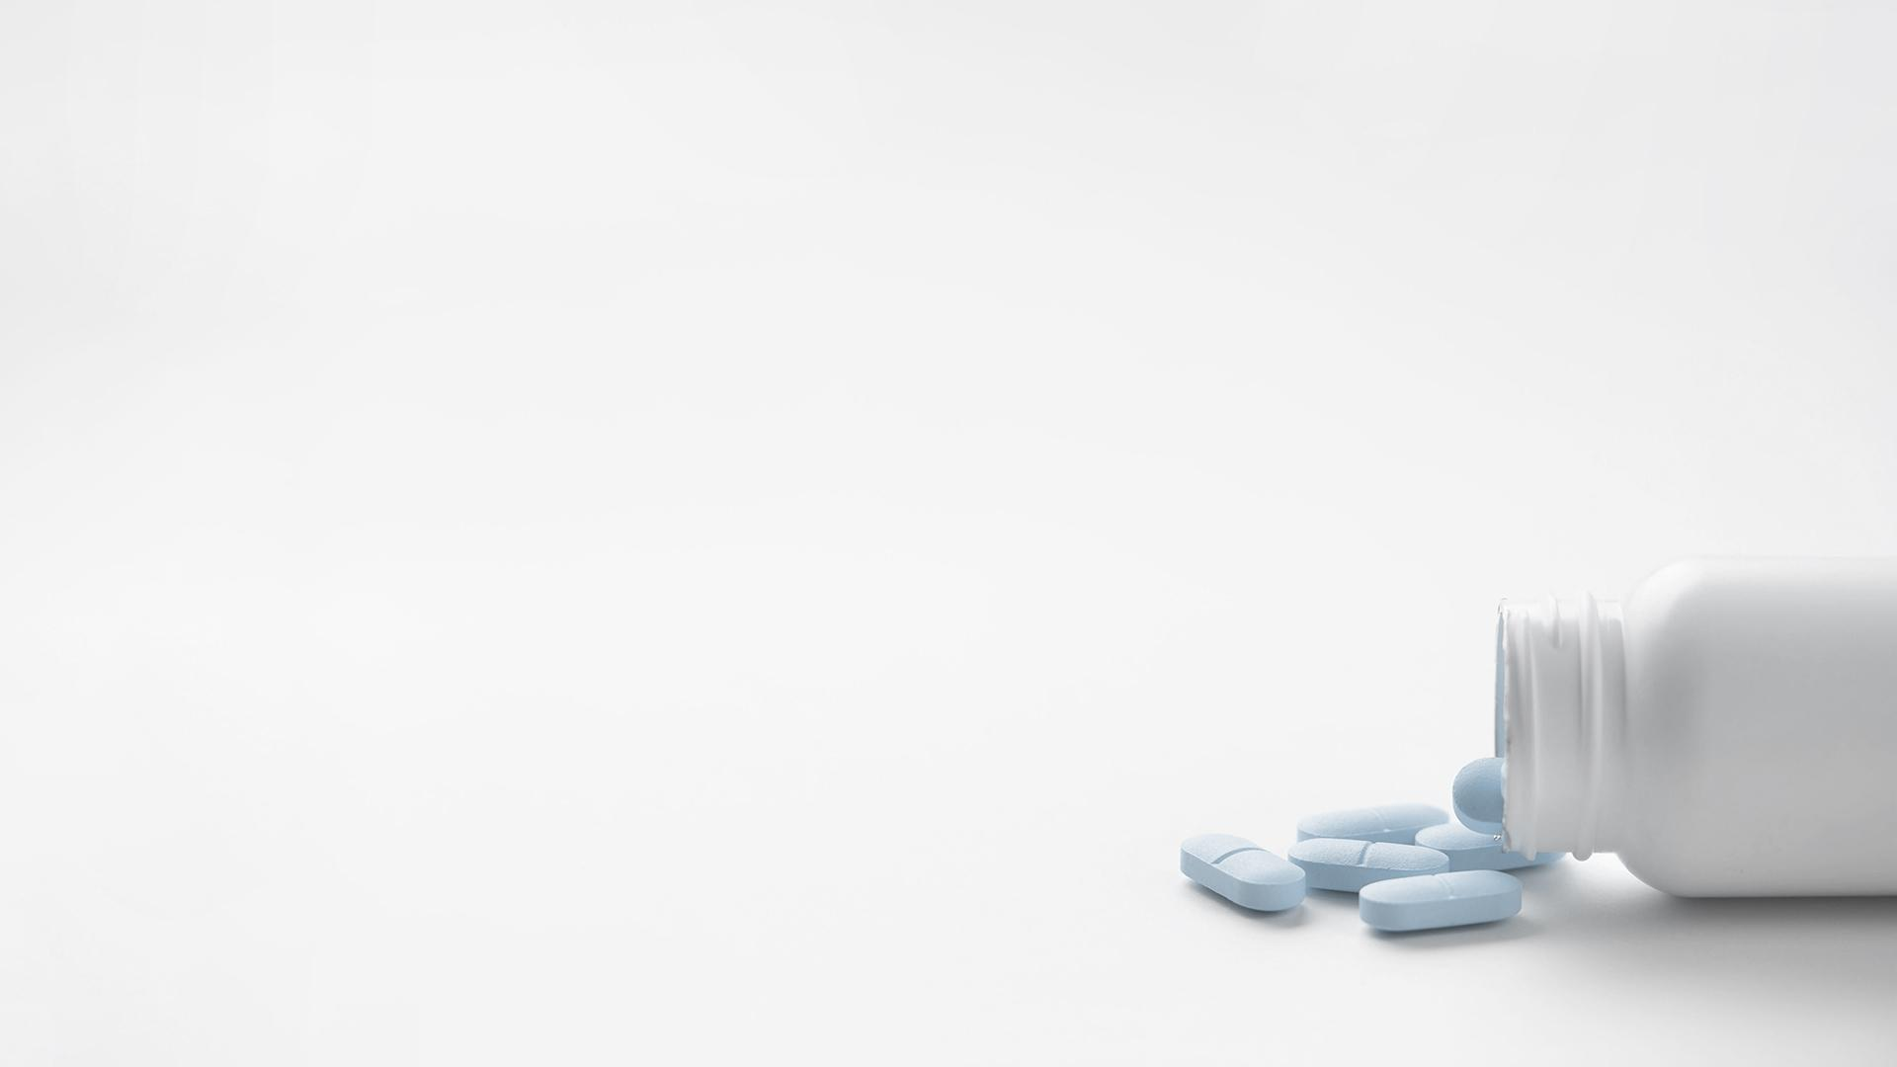
REFERENCES
AUTHOR | YEAR | TITLE | PUBLISHER
Martin, D. | 2001 | Mars | Publisher 1
Quintana, M. | 2015 | Venus | Publisher 2
Robbins, A. | 2018 | Mercury | Publisher 3
Donohue, A. | 2019 | Saturn | Publisher 4

Slide 22
ALTERNATIVE RESOURCES
An overhead view of medical pills and equipments on white background
Stethoscope in foreground
Receptacles with liquid in laboratory
Checking x ray scan
Medical treatment with pills
Medical doctor wearing gloves
Medical team in a doctor's office
Doctor hand with syringe
Close-up of a male doctor hand holding chest x-ray
Doctor holding pills in hand
Family doctor with a face mask
Medical equipment with a injection for a vaccine
Capsules and tablets with depression label on white background
Doctor analyzing with a microscope
Doctor tending to a patient
Stethoscope on ecg paper graph and laptop on white backdrop

Slide 23
RESOURCES
Did you like the resources on this template? Get them for free at our other websites.
VECTORS
Variety of round charts
PHOTOS
X ray of a human head
Family doctor in a doctor's office
Doctor analyzing with a microscope
Doctor tending to a patient
Doctor tending to a patient
Doctor tending to a patient
Doctor analyzing with a microscope
Doctors analyzing a radiograph
Doctor tending to a patient
Medical treatment with pills
Medical report with medical equipment
Doctor with a medical report
Family doctor in a doctor's office
Family doctor in a doctor's office
Yellow pills spilled from bottle isolated over white background
Stethoscope and keyboard with pills spilling out from bottle on white background

