Slide 1
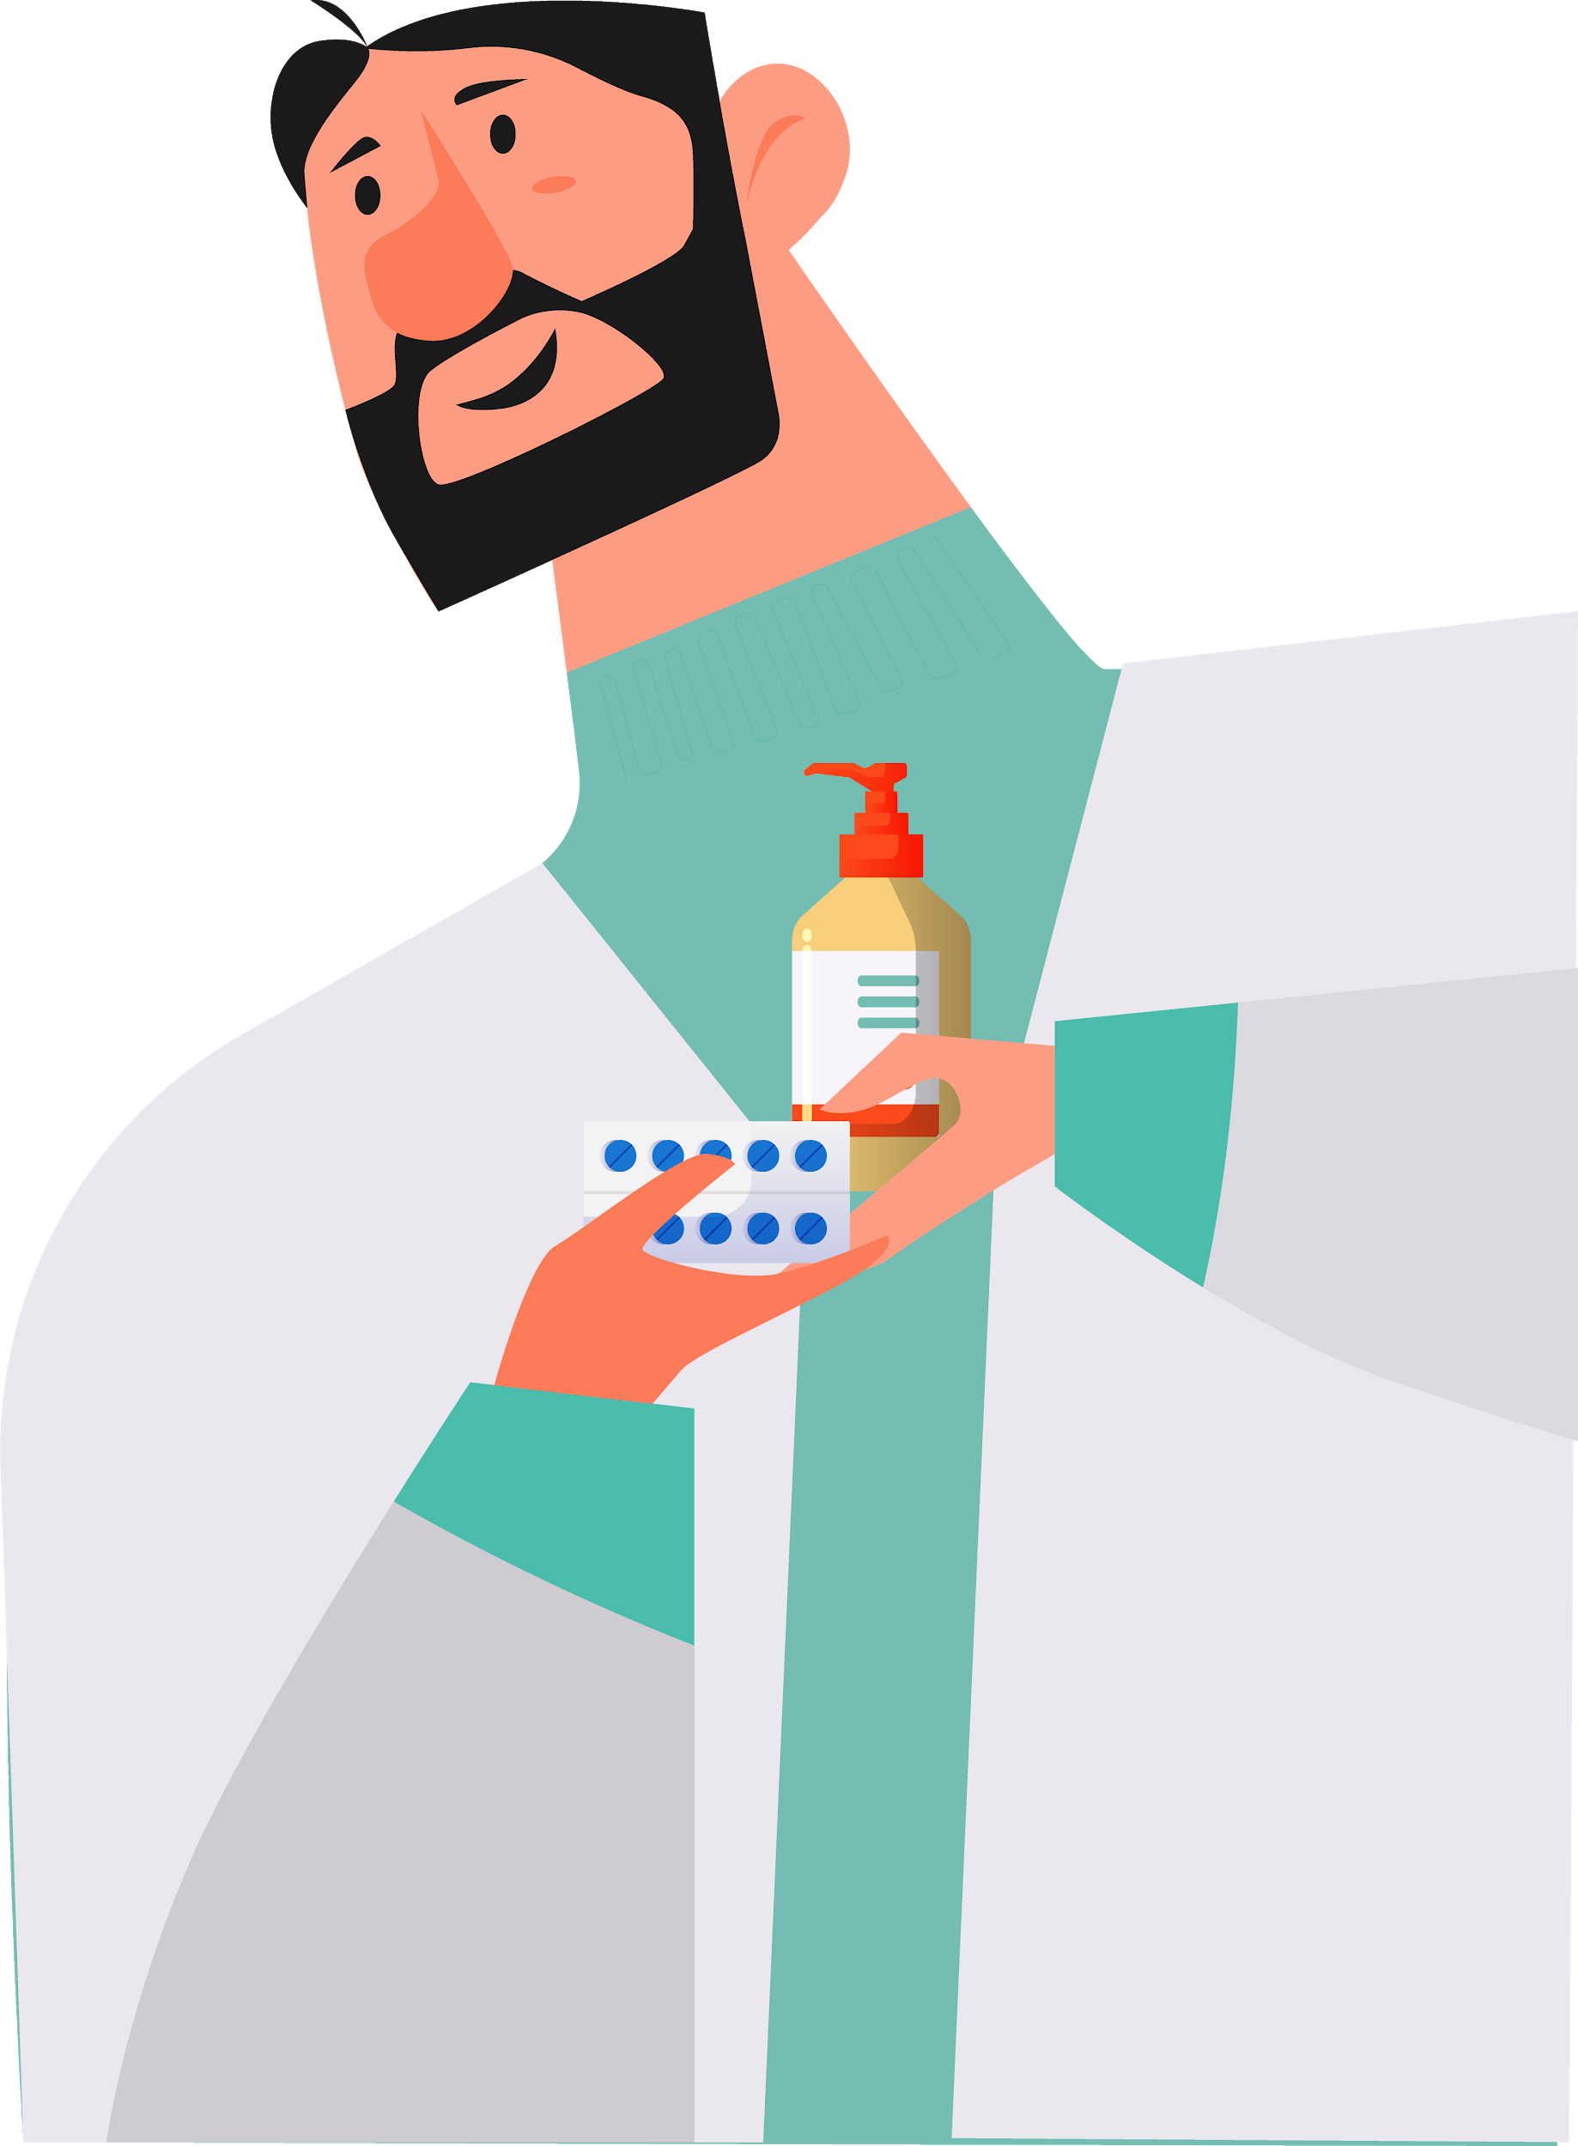

Slide 2
Objectives
01
Methodology
02
TABLE OF CONTENTS
Results Analysis
03
Conclusions
04
Here you could describe the topic of the section
Here you could describe the topic of the section
Here you could describe the topic of the section
Here you could describe the topic of the section

Slide 3
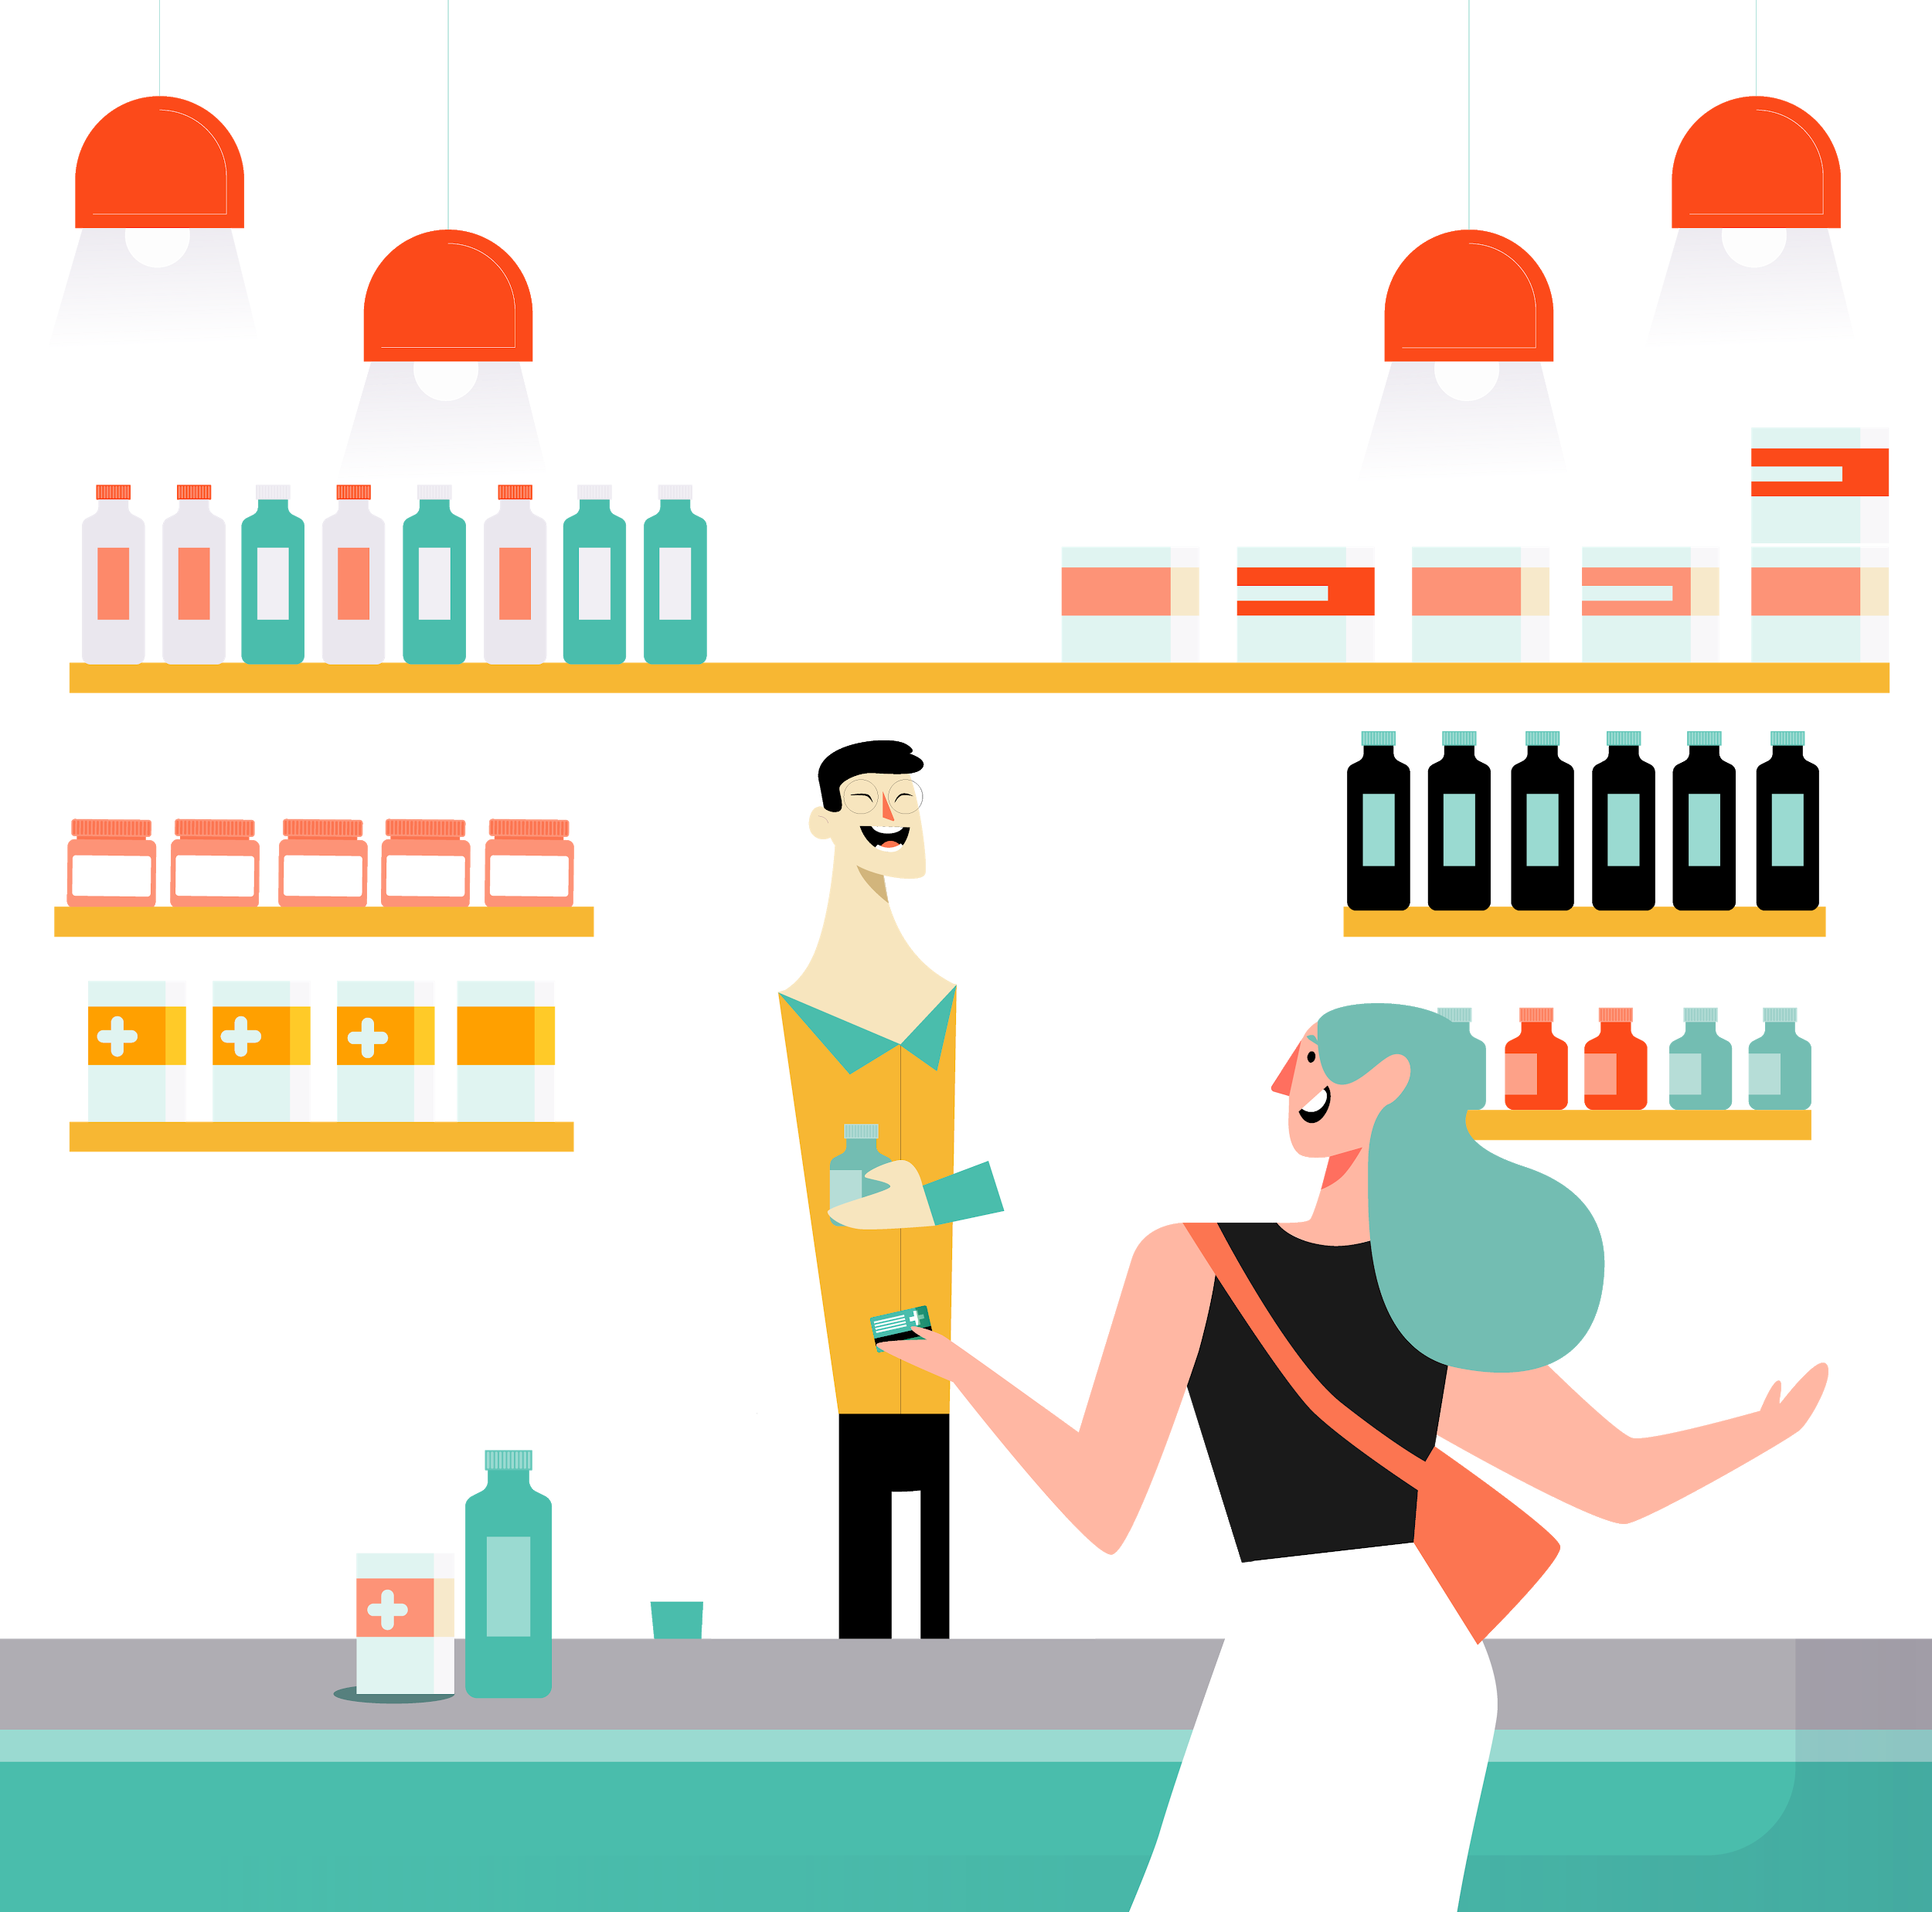
INTRODUCTION
Mercury is the closest planet to the Sun and the smallest one in the Solar System—it’s only a bit larger than our Moon. The planet’s name has nothing to do with the liquid metal since it was named after the Roman messenger god, Mercury

Slide 4
BACKGROUND
MERCURY
MARS
JUPITER
VENUS
SATURN
NEPTUNE
Mercury is the closest planet to the Sun
Despite being red, Mars is a cold place, not hot
It’s the biggest planet in our Solar System
Venus has a beautiful name, but it’s very hot
Saturn is the ringed planet and a gas giant
Neptune is the farthest planet from the Sun

Slide 5
GOALS
MERCURY
JUPITER
Mercury is the smallest planet in our Solar System. In fact, it’s only a bit larger than our Moon
Despite being red, Mars is a cold place, not hot. It’s full of iron oxide dust, which gives the planet its reddish cast

Slide 6
METHODS
METHODS
1 IDENTIFY
2 RESEARCH
3 EVALUATION
Venus has a beautiful name and is the second planet from the Sun. It’s terribly hot
Despite being Red, Mars is a cold place. It’s full of iron oxide dust, giving the planet its reddish cast
Mercury is the closest planet to the Sun and the smallest one in our Solar System

Slide 7
RESEARCH AND PUBLICATIONS
by MERCURY
by VENUS
by MARS
Mercury is the closest planet to the Sun and the smallest one in our Solar System—it’s only a bit larger than our Moon
Venus has a beautiful name and is the second planet from the Sun. It’s terribly hot, even hotter than Mercury
Despite being red, Mars is a cold place, not hot. It’s full of iron oxide dust, which gives the planet its reddish cast

Slide 8
RESEARCH RESOURCES
Here you can list your reference websites or publications.
Here you can list your reference websites or publications.
Here you can list your reference websites or publications.
Here you can list your reference websites or publications.
Here you can list your reference websites or publications.
Here you can list your reference websites or publications.

Slide 9
FACTORS TO CONSIDER
VENUS
MERCURY
JUPITER
Venus has a beautiful name, but it’s too hot
Mercury is the closest planet to the Sun
It’s the biggest planet in our Solar System

Slide 10
CLINICAL TRIAL
PRECLINICAL
PHASE 1
PHASE 2
PHASE 3
Lab Studies
Human Safety
Expanded Safety
Efficacy & Safety
5%
5%
45%
Mercury is the closest planet to the Sun and the smallest one
65%
95%
95%

Slide 11
01
RESEARCH
02
PRECLINICAL
03
TRIAL TIMELINE
EXPERIMENTATION
04
RESULTS
05
CONCLUSIONS
Venus has a beautiful name, but it’s terribly hot
Despite being red, Mars is a cold place, not hot
Mercury is the smallest planet in our Solar System
Jupiter is the biggest planet in our Solar System
Neptune is the farthest planet from the Sun

Slide 12
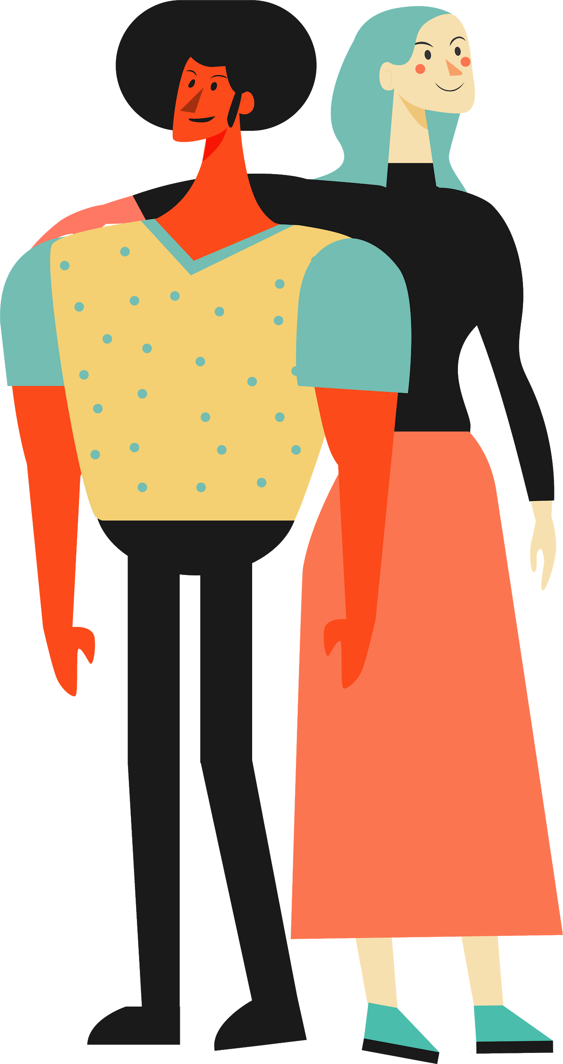
PHASE 1
SAMPLE GROUP
SECONDARY EFFECTS
5%
10%
30%
8%
SAFE DOSE
RESULTS
85%
Success rate
6 wks
Experimentation time
200mg/day
20 - 80 Participants
Ages between 25 and 45
Venus
Mars
Mercury
Neptune
Mercury is the closest planet to the Sun and also the smallest one in our Solar System—it’s only a bit larger than our Moon. The planet’s name has nothing to do with the liquid metal, since it was named after the Roman messenger god, Mercury

Slide 13
TENDENCY
VENUS
MARS
SATURN
Mercury is the closest planet to the Sun and the smallest one in the Solar System—it’s only a bit larger than our Moon. The planet’s name has nothing to do with the liquid metal, since it was named after the Roman messenger god, Mercury
If you want to modify these graphs, click on them, follow the link, change the data and replace them

Slide 14
RESULTS
Experiment A
Experiment B
 | OUTCOME
TREATMENT | Test 1 | Test 2 | Test 3
Group 1 | 315 | 285 | 600
Group 2 | 210 | 390 | 600
Group 3 | 240 | 165 | 580
 | OUTCOME
TREATMENT | Test 1 | Test 2 | Test 3
Group 1 | 189 | 285 | 474
Group 2 | 210 | 234 | 444
Group 3 | 367 | 123 | 396

Slide 15
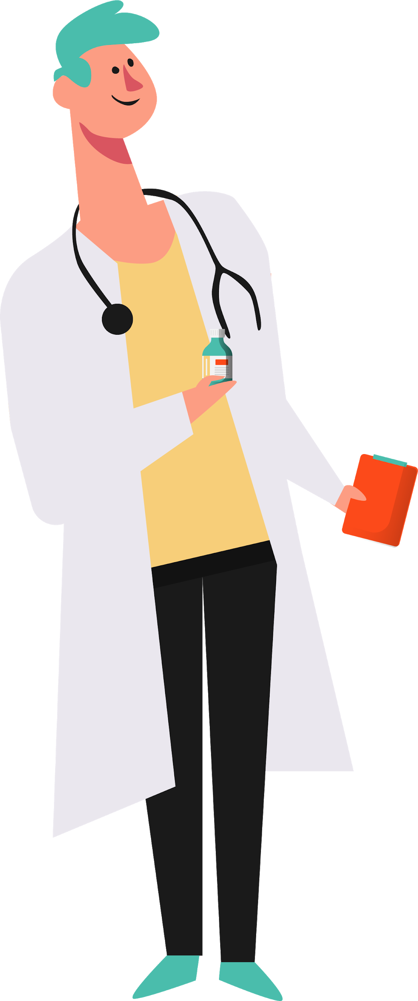
RESULTS ANALYSIS
SATURN
JUPITER
MERCURY
80%
90%
50%
45%
VENUS
NEPTUNE
PLUTO
MARS
CERES
HAUMEA
Mercury is the closest planet to the Sun
Venus has a beautiful name, but it’s very hot
Despite being red, Mars is a cold place

Slide 16
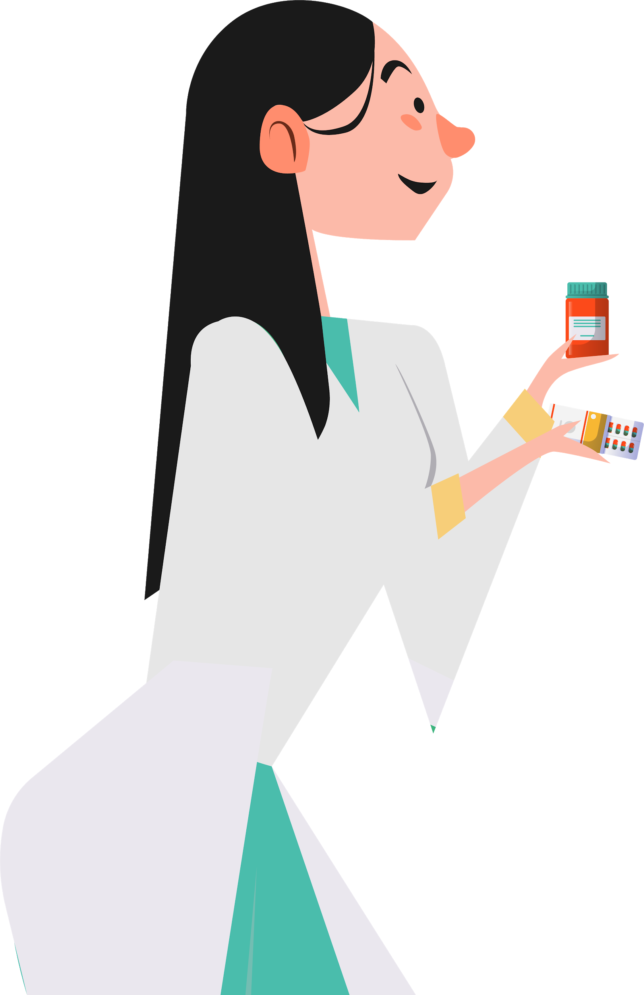
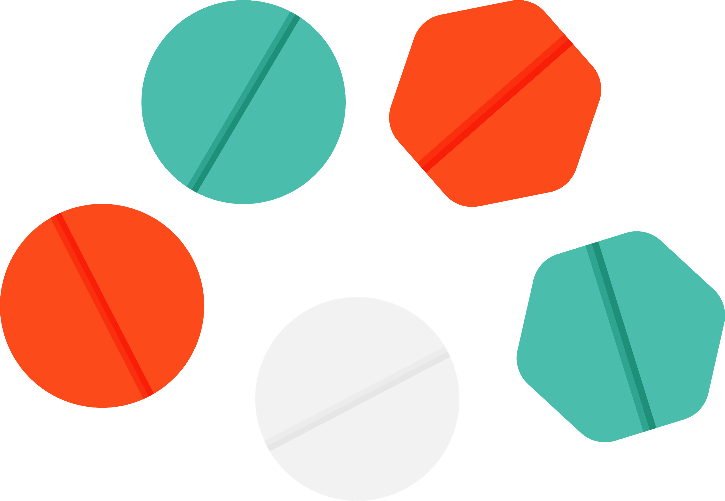
SUCCESS RATE
75%
Patients cured
90%
Without secondary effects

Slide 17
CONCLUSIONS
Mercury is the closest planet to the Sun and the smallest one in the Solar System—it’s only a bit larger than our Moon. The planet’s name has nothing to do with the liquid metal since it was named after the Roman messenger god, Mercury

Slide 18
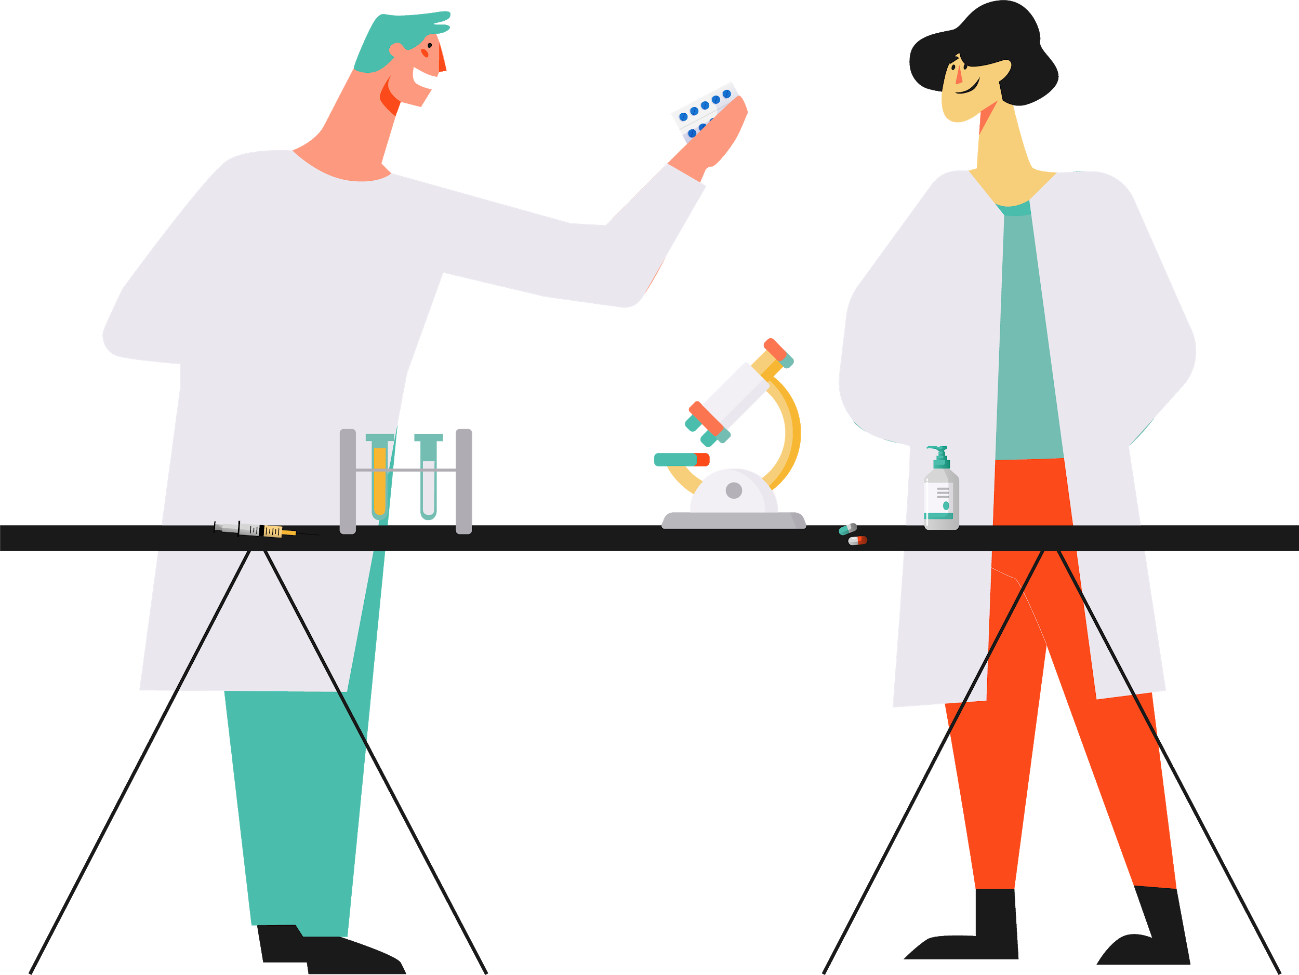
THANKS
Does anyone have any questions?

Slide 19
CREDITS
This is where you give credit to the ones who are part of this project.
Presentation template by Slidesgo
Icons by Flaticon
Infographics by Freepik
Images created by Freepik
Author introduction slide photo created by Freepik
Text & Image slide photo created by Freepik.com

Slide 20
RESOURCES
Did you like the resources on this template? Get them for free at our other websites.
ICONS
Pack medical 148
Pack addictions 2
Pack social media 23
Icon cry
Icon team
VECTORS
Lovely marriage proposal with flat design
Flat pharmacist objects collection
Pharmacist with customer
Flat business landing page template
Flat people going to university collection
Situations of people at office flat collection
Flat nurse team
No tobacco day banners with skull and tomb
Diversity concept flat style background
Flat pharmacist objects collection
Background of medical care items
Medicine elements background in flat style

