Slide 2
CONTENTS OF THIS TEMPLATE
Here’s what you’ll find in this Slidesgo template:
A slide structure based on a breakthrough presentation, which you can easily adapt to your needs. For more info on how to edit the template, please visit Slidesgo School or read our FAQs.
An assortment of pictures for use in the presentation can be found in the alternative resources slide.
A thanks slide, which you must keep so that proper credits for our design are given.
A resources slide, where you’ll find links to all the elements used in the template.
Instructions for use.
Final slides with:
The fonts and colors used in the template.
More infographic resources, whose size and color can be edited.
Sets of customizable icons of the following themes: general, business, avatar, creative process, education, help & support, medical, nature, performing arts, SEO & marketing, and teamwork.
You can delete this slide when you’re done editing the presentation.

Slide 3
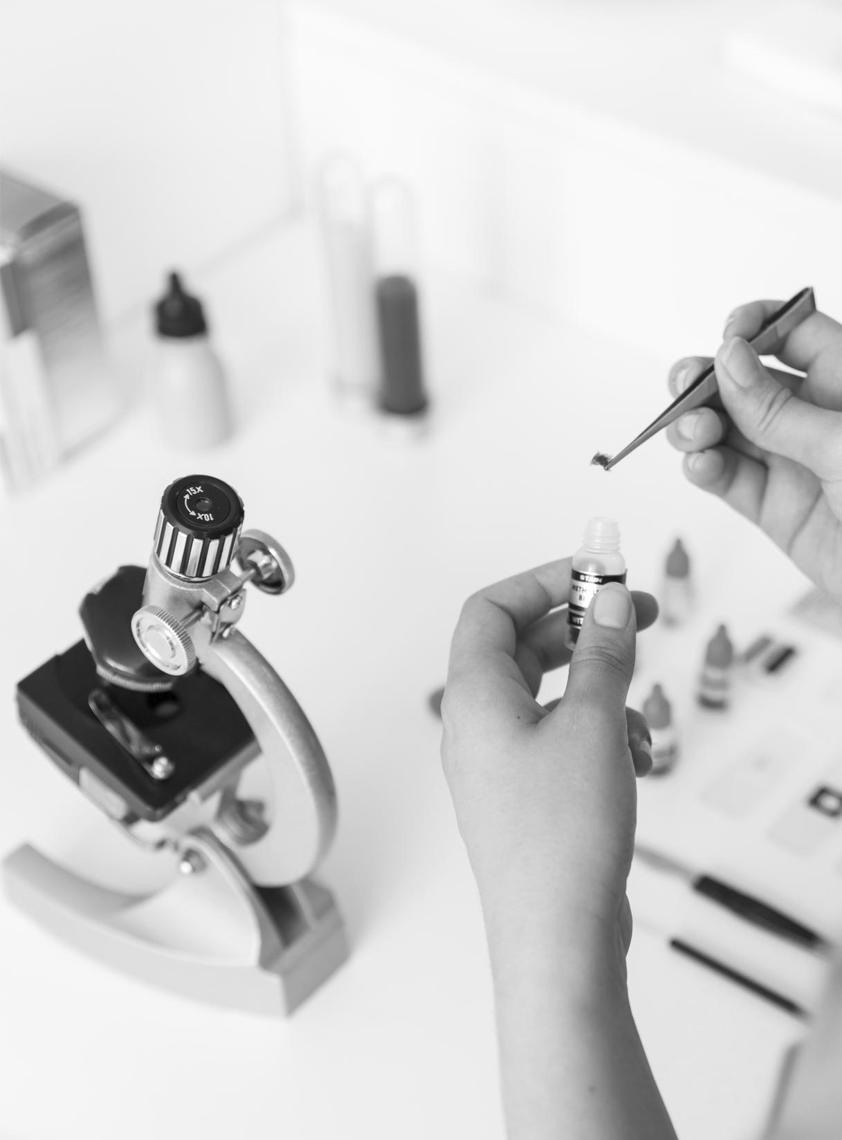
TABLE OF CONTENTS
01
02
03
04
OBJECTIVES
METHODOLOGY
RESULTS ANALYSIS
CONCLUSIONS
Here you could describe the topic of the section
Here you could describe the topic of the section
Here you could describe the topic of the section
Here you could describe the topic of the section

Slide 4
INTRODUCTION
INTRODUCTION
Mercury is the closest planet to the Sun and the smallest one in the Solar System—it’s only a bit larger than our Moon. The planet’s name has nothing to do with the liquid metal since it was named after the Roman messenger god, Mercury

Slide 5
BACKGROUND
MERCURY
MARS
JUPITER
VENUS
SATURN
NEPTUNE
Mercury is the closest planet to the Sun
Despite being red, Mars is actually a cold place
It’s the biggest planet in our Solar System
Venus has a beautiful name, but it’s terribly hot
Saturn is the ringed one and a gas giant
Neptune is the farthest planet from the Sun

Slide 6
GOALS
01
02
03
MERCURY
VENUS
JUPITER
Mercury is the closest planet to the Sun and the smallest one in the Solar System—it’s only a bit larger than our Moon
Venus has a beautiful name and is the second planet from the Sun. It’s terribly hot—even hotter than Mercury
Despite being red, Mars is actually a cold place. It’s full of iron oxide dust, which gives the planet its reddish cast

Slide 7
METHODS
04: SATURN
01: MERCURY
05: VENUS
02: MARS
06: NEPTUNE
03: JUPITER
Saturn is composed of hydrogen and helium
Mercury is the closest planet to the Sun
Venus has a beautiful name, but it’s very hot
Despite being red, Mars is actually a cold place
Neptune is the farthest planet from the Sun
It’s the biggest planet in our Solar System

Slide 8
RESEARCH AND PUBLICATIONS
By Venus
By Mars
By Mercury
“Mercury is the closest planet to the Sun and the smallest one in the
Solar System—it’s only a bit larger
than our Moon”
“Venus has a beautiful name and is the second planet from the Sun. It’s terribly hot, even hotter than Mercury”
“Despite being red, Mars is actually a cold place. It’s full of iron oxide dust, which gives the planet its reddish cast”

Slide 9
RESEARCH RESOURCES
● Here you can list your reference websites or publications.
● Here you can list your reference websites or publications.
● Here you can list your reference websites or publications.
● Here you can list your reference websites or publications.
● Here you can list your reference websites or publications.
● Here you can list your reference websites or publications.

Slide 10
FACTORS TO CONSIDER
MERCURY
VENUS
JUPITER
MARS
Mercury is the closest planet to the Sun and the smallest one
Venus has a beautiful name and is the second planet from the Sun
Jupiter is a gas giant and the biggest planet in our Solar System
Despite being red, Mars is actually a cold place. It’s full of iron oxide dust

Slide 11
CLINICAL TRIAL
 | PHASE 1 | PHASE 2 | PHASE 3
PARTICIPANTS | 200 | 600 | 1200
DOSE | 10 / person | 6 / person | 2 / person
CONCLUSIONS | Human Safety | Expanded Safety | Efficacy & Safety
PRECLINICAL:
Lab Studies

Slide 12
TRIAL TIMELINE
RESEARCH
EXPERIMENTATION
CONCLUSIONS
PRECLINICAL
RESULTS
Mercury is the closest planet to the Sun
Jupiter is the biggest planet in our Solar System
Venus has a beautiful name, but it’s very hot
Despite being red, Mars is actually a cold place
Mercury is the closest planet to the Sun

Slide 13
PHASE 1
SAMPLE
RESULTS
6 MONTHS
80
PARTICIPANTS
SECONDARY EFFECTS
80%
90%
70%
SUCCESS
WOMEN
MEN
45%
55%
Mercury is the closest planet to the Sun and the smallest one in the Solar System—it’s only a bit larger than our Moon

Slide 14
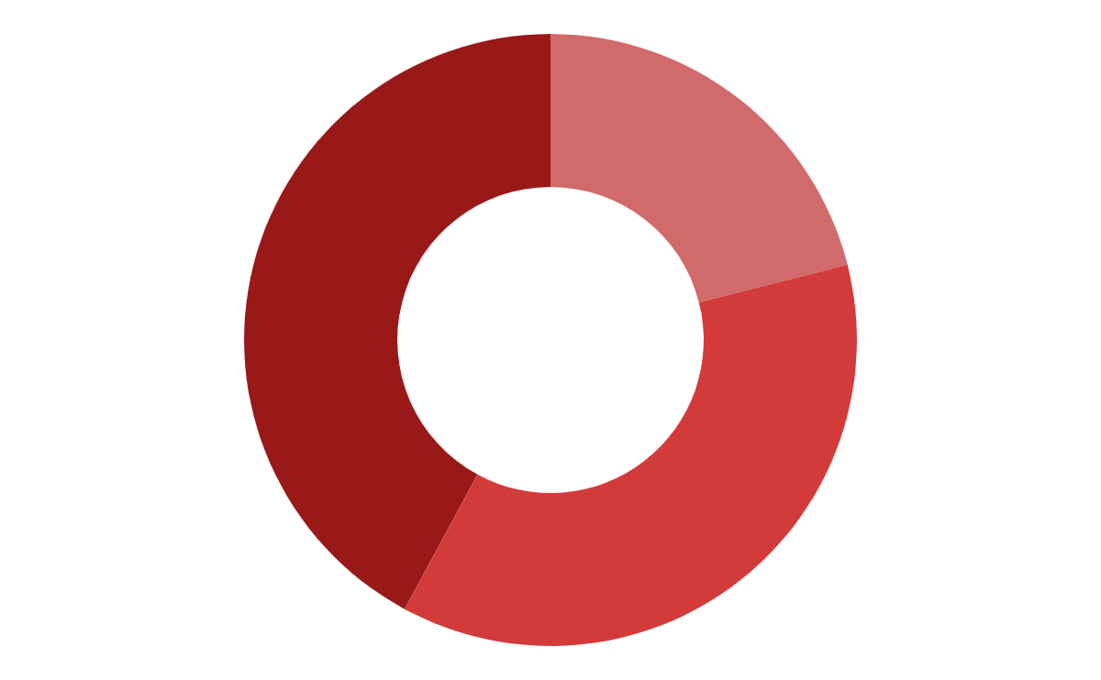
TENDENCY
40%
MARS
20%
JUPITER
40%
SATURN
If you want to modify these graphs, click on them, follow the link, change the data and replace them

Slide 15
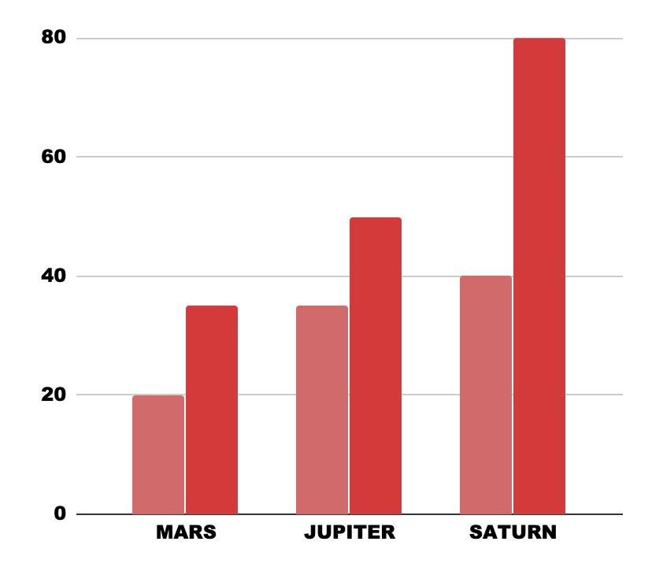
RESULTS
EXPERIMENT A
EXPERIMENT B
TEST 1
TEST 2
 | TEST 1 | TEST 2 | TEST 3
GROUP 1 | 300 | 310 | 450
GROUP 2 | 546 | 642 | 566
GROUP 3 | 666 | 789 | 987
Mercury is the closest planet to the Sun
Despite being red, Mars is actually a cold place
If you want to modify these graphs, click on them, follow the link, change the data and replace them

Slide 16
RESULTS
20%
50%
30%
Venus has a beautiful name, but it’s terribly hot
Mercury is the closest planet to the Sun
Saturn is composed of hydrogen and helium
Jupiter is the biggest planet in our Solar System
Neptune is the farthest planet from the Sun
Despite being red, Mars is actually a cold place
The planet Earth is where we live on

Slide 17
SUCCESS RATE
80%
322
745
MARS
JUPITER
SATURN

Slide 18
CONCLUSIONS
Mercury is the closest planet to the Sun and the smallest one in the Solar System—it’s only a bit larger than our Moon. The planet’s name has nothing to do with the liquid metal, since it was named after the Roman messenger god

Slide 19
ALTERNATIVE RESOURCES
Medical treatment with pills
Medical treatment with pills
Doctor showing the size of a thing
Tender hand in hand
Content couple bonding at table and enjoying tea
Happy man holding his girlfriend in his arms
An elevated view of stethoscope over the medical ecg report near the keyboard
Cup of coffee with red toy heart and medical accessories over desk
Close-up woman holding up a condom
Contraceptive methods
Doctor drawing ekg
Woman with aching stomach
If you want to apply the same filter as the pictures already included in the template, follow these instructions:
IN GOOGLE SLIDES:
Insert the picture into the slide.
Select the picture, go to Format options and, on the Recolor tab, choose a black & white filter.

Slide 20
RESOURCES
Do you like the resources on this template? Get them for free at our other websites
PHOTOS
Crop couple holding hands
High angle happy couple hugging
Medical treatment with pills
Test tube in latex glove
Scientist making test in laboratory
Medical treatment with pills
Young female veterinarian working in the laboratory
Woman with migraine
Composition of notebook and stethoscope
VECTORS
Medical healthcare infography
Marketing evolution chart business template
Gradient infographic steps template
ICONS
Biology Pack
Healthcare And Medical Icon Pack

